Slide 1
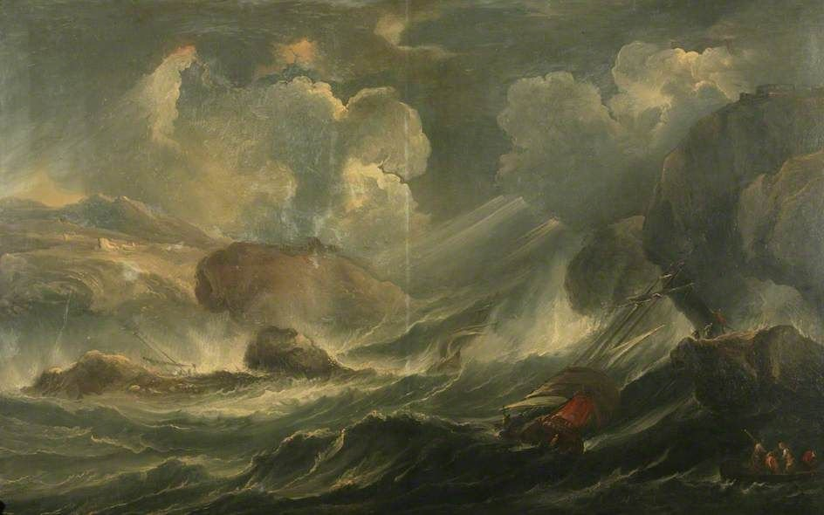
The Great Storm of 1286

Slide 2
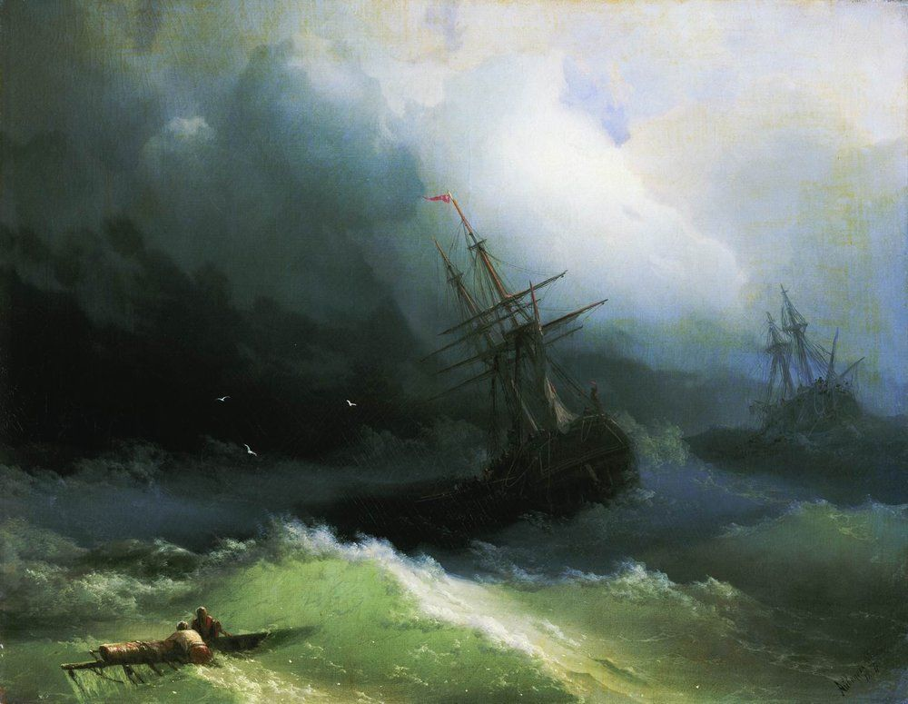
LO: to plan a recount with a flashback.
GOOD: I can plan my story in chronological order.
BETTER: I can use a boxed-up plan template to order my paragraphs. I can start at the most dramatic point and include a flashback
BEST: My story plan is detailed. I have a clear understanding of how I will start, introduce the flashback and how my recount will end.

Slide 3
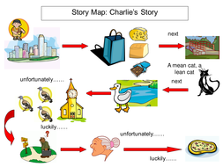
Plan first in chronological order. Use a storymap to help you.

Slide 4
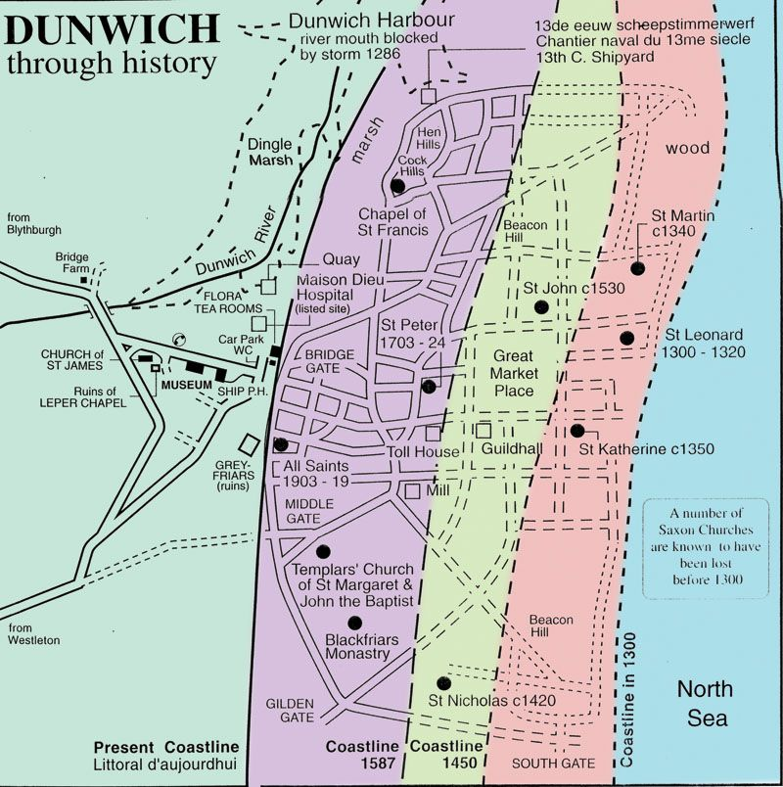
An introduction
What will happen first to your character? How will we get to know them? What chore have they been sent to do? Use the map to help you.
Maybe they’ve been sent to the market or the harbour. Perhaps they have been sent to light a candle in a nearby church. Maybe they’ve been sent to take food to a relative in the lepers’ hospital.
Extension: You could use ‘foreshadowing’ here by sharing your character’s concerns about the weather. Perhaps the clouds are getting darker and the wind is picking up.

Slide 5
The build up
At this point in the story the storm will be starting.
How will people be preparing for the gathering storm?
What will traders in the market be doing? What about the fishermen in the docks?
What will people be saying to each other?
What will your character be thinking as the weather becomes more severe?
How can you show that the storm is becoming stronger?

Slide 6
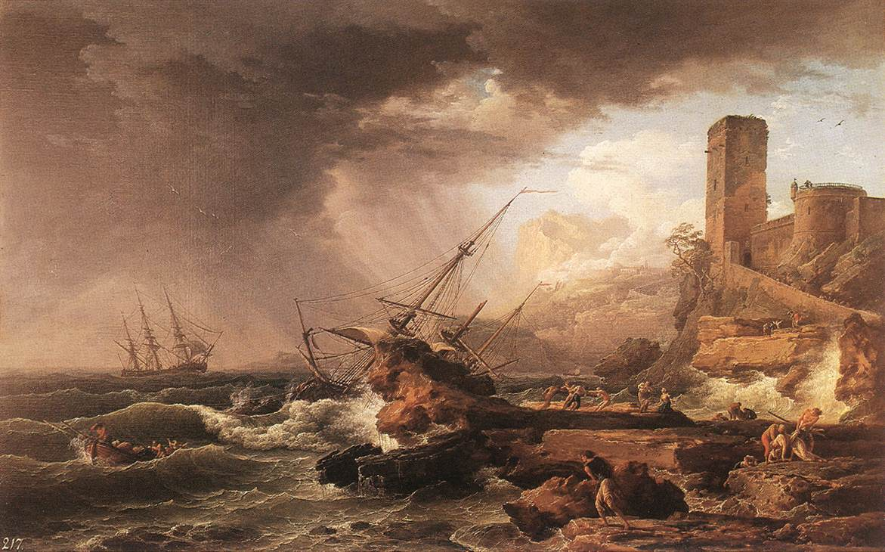
The problem
This is the most dramatic point of your story. The storm is at its strongest and your character is in trouble.
What is the problem?
How can you use show-don’t-tell to share your character’s desperate feelings and the fear?
What imagery will you use to describe the raging storm?

Slide 7
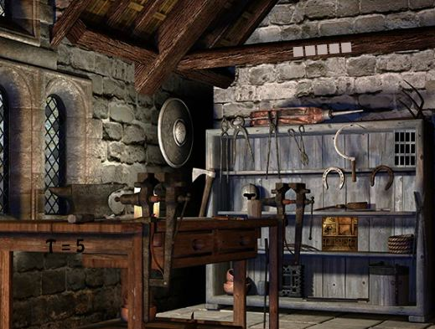
The resolution
How will your character solve the problem?
Will they rescue something or someone?
Will they need to escape from somewhere?
At this point you will want to use a mixture of longer and shorter sentences to change the pace and add drama to your writing.

Slide 8
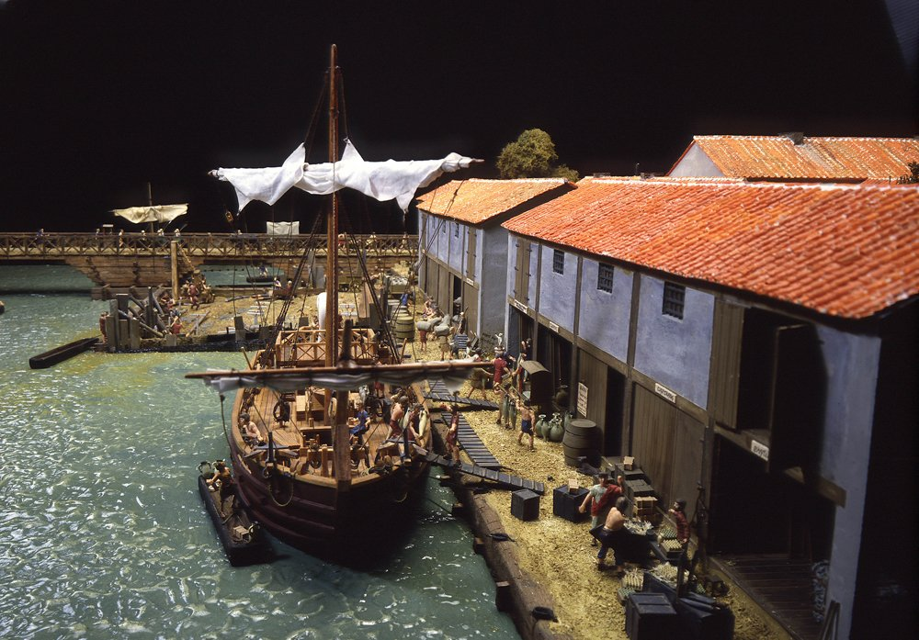
The ending
How will the story come to an end?
What will Dunwich look like after the storm?
What changes have taken place? What has been lost to the sea? Who is missing? What has happened to the harbour?
What will your character be feeling about the future?

Slide 9
Now use the boxed up plan to reorder your story so that it starts at the most dramatic point.
How will you introduce your flashback?

