Slide 1
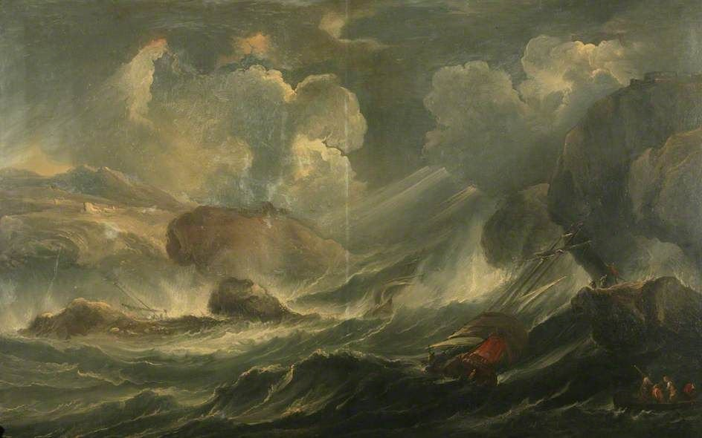
The Great Storm of 1286

Slide 2
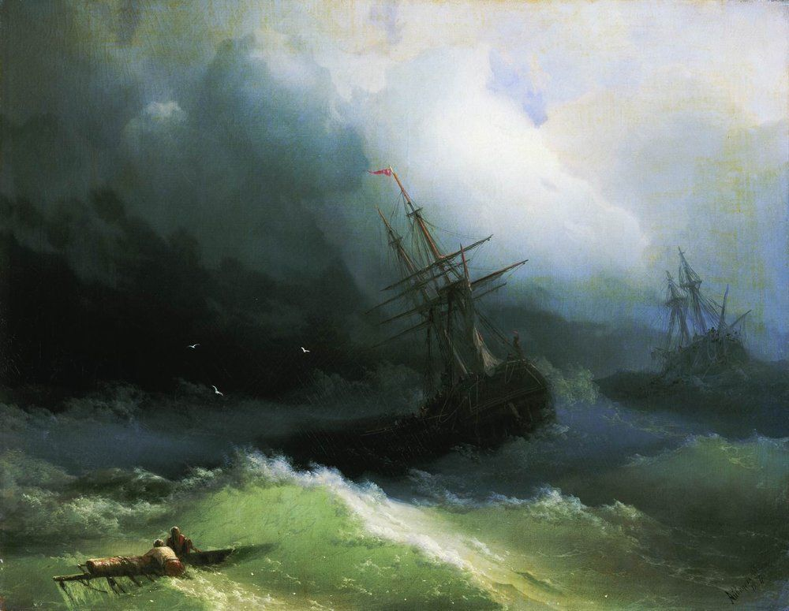
LO: to include a flashback in my story.
GOOD: I have included a flashback that reveals how my character ended up in the danger he/she was in at the start.
BETTER: I have used a trigger to introduce my flashback, and another trigger to return to the present. My flashback paints a vivid picture of life in Dunwich before the storm.
BEST: I have continued to use sentence skills and engaging description throughout.

Slide 3
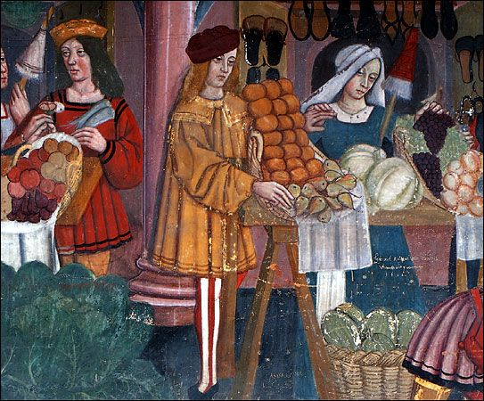
What is the flashback for?
The flashback will help your reader understand how your character got into such a mess in the first place.
It is your chance to describe what everyday life was like in Dunwich for your character before the storm came.
It gives your reader some context (some background information) about your character.

Slide 4
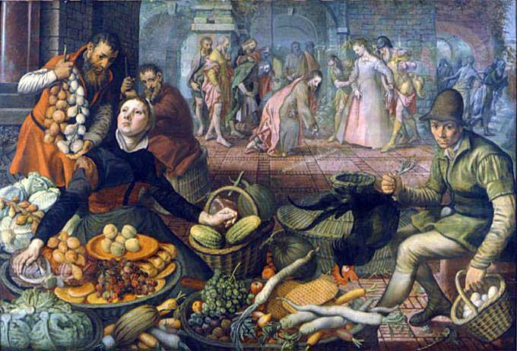
Use a trigger to introduce the flashback.
Think about when you are suddenly pulled into a memory. Memories don’t usually come from nowhere – they are usually triggered by something from the present.
This could be: something seen, something felt, something smelt…
Perhaps your character notices someone else struggling in the water that they had bought fish from at the harbour the day before, or someone who had shooed them away from their stall with a broom. This could trigger a flashback.
Maybe something sails past them in the wind that they recognise – a bucket that they had been asked to empty out yesterday, or a red shawl that their sister always wore. This could be the trigger for a flashback.
Or maybe they just suddenly realise how quickly their life has changed. “How have I ended up here?” I thought. “It was only yesterday that I was in the market buying eggs.” This could be the start of a flashback.

Slide 5
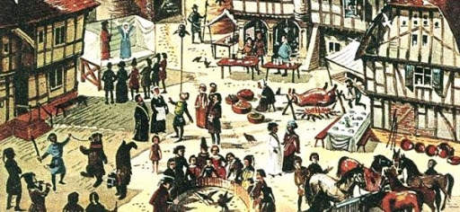
Use a trigger to move back to the present.
Just as there is a reason for your character to enter the flashback, there should be a reason why he/she is pulled back to the present as well.
For example, if, in the flashback, your character is remembering the maid washing the kitchen floor, a splash of water on his face could bring him back to the present.
Or, your character could be remembering the fishing boats in the harbour, and might notice the very same boat being overturned by a huge wave in front of him.

Slide 6
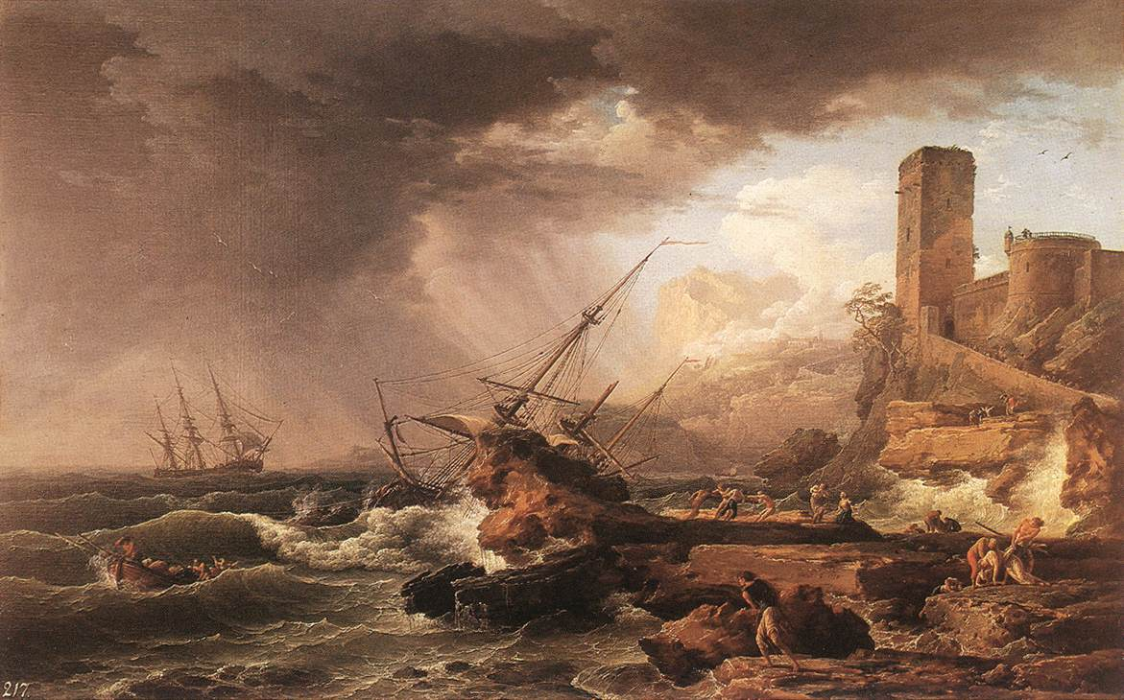
Remember to keep using your sentence skills.
Keep using the descriptive language you have been using so far to engage all your reader’s senses and to paint a vivid picture of life in old Dunwich.
Use and include the information from your research to make your story sound authentic (believable).
Stay in the past tense.

