Slide 1
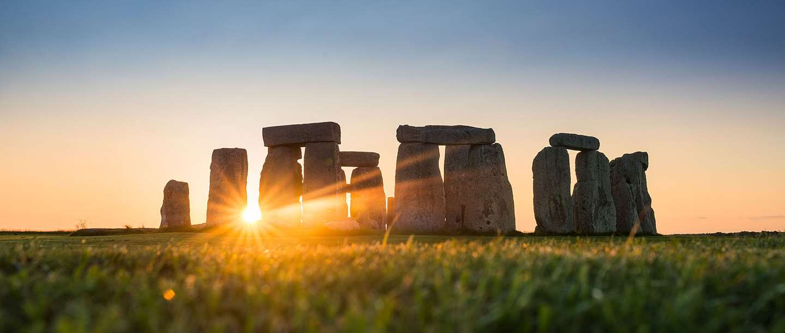
A time of great change: from the Stone Age to the Iron Age

Slide 2
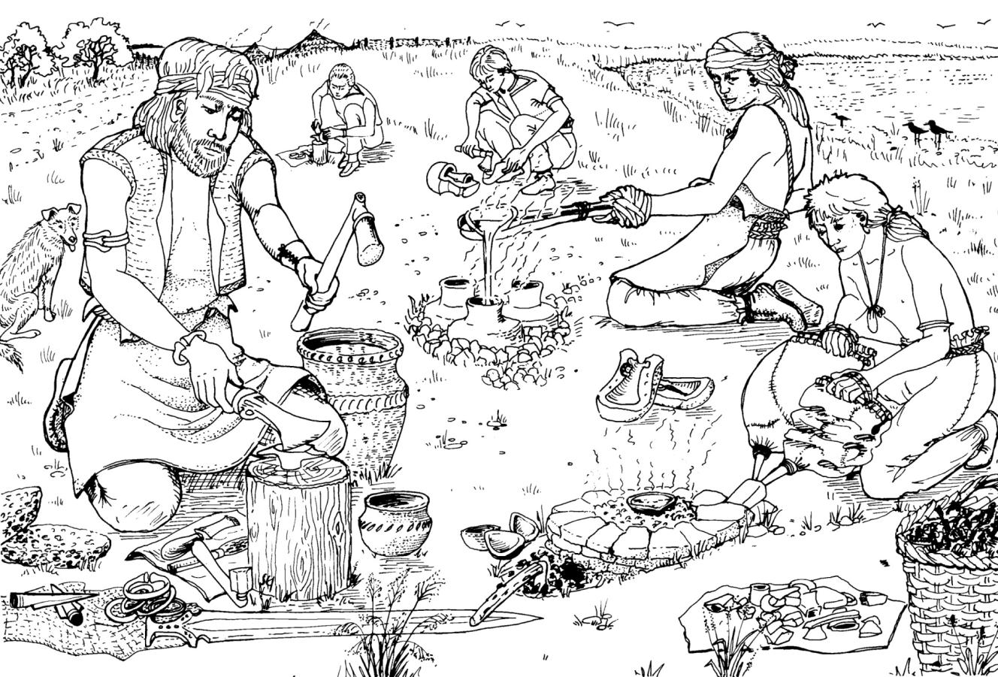
WEEK 8 Key Question: Who were the Beaker People?
LO:
To know that new people arrived in Britain during the Bronze Age.
To know what new technologies they brought with them, and how this changed the lifestyles of people living in Britain.
Skills Objective:
To use evidence to draw a labelled picture of the Amesbury Archer.

Slide 3
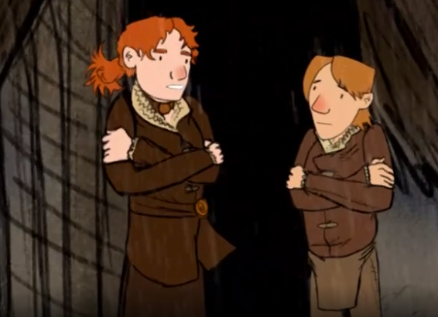
The Bronze Age
Last week, we learnt how to make bronze. We found out that the Bronze Age was the start of the metal ages in Britain.
Watch this introduction to the Bronze Age to find out how life has changed for the family we followed through the Stone Ages: https://www.bbc.co.uk/teach/class-clips-video/story-of-britain-bronze-age-britain/znrygwx

Slide 4
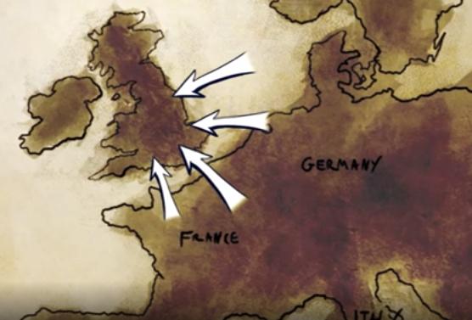
New people arrive
Around 2500BC settlers from mainland Europe brought a new skill to Britain. They were metalworkers who knew how to work with copper. Gradually, Britons learned to make objects from copper, gold and bronze.
By 2100BC, Britons were mining metals. Trading ships travelled to mainland Europe carrying copper, tin and precious objects made by metalworkers.
Some settlers who arrived belonged to the Beaker culture. Beaker people lived in clans led by powerful chiefs. Their customs became part of life in Ancient Britain, and this period became known as the Bronze Age.

Slide 5
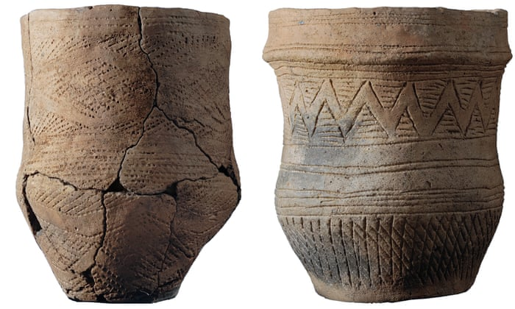
The Beaker People
These people are named for the distinctive decorated pottery cups they used. Archaeologists have found many of these ‘beakers’ buried with them in their graves.

Slide 6
DNA evidence
By looking carefully at the DNA in bones found in burial chambers, scientists discovered that the Beaker People were completely different to the people who lived here before. After they arrived, we find very little evidence of the people who had lived here before. This means the Beaker People must have taken over the British Isles.
What do you think happened to these people?
You can read more about this here: https://www.nhm.ac.uk/discover/news/2018/february/the-beaker-people-a-new-population-for-ancient-britain.html

Slide 7
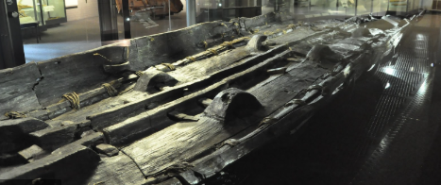
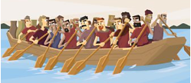
How did people travel in the Bronze Age?
During the Bronze Age, many people crossed the sea from mainland Europe to Britain. They travelled in long wooden boats rowed by oarsmen.
The boats carried people, animals and trading goods. They were loaded with metal from mines, precious swords, pots and jewellery.
Boats were very useful for carrying heavy materials like stone. Large areas of land were covered by forest, so it was much easier to transport goods by river.
The Dover Boat is an example of Bronze Age boat. In fact it is the oldest know sea-going boat in the world. It needed 18 people to row it. You can find out more here: https://www.dovermuseum.co.uk/Bronze-Age-Boat/Bronze-Age-Boat.aspx

Slide 8
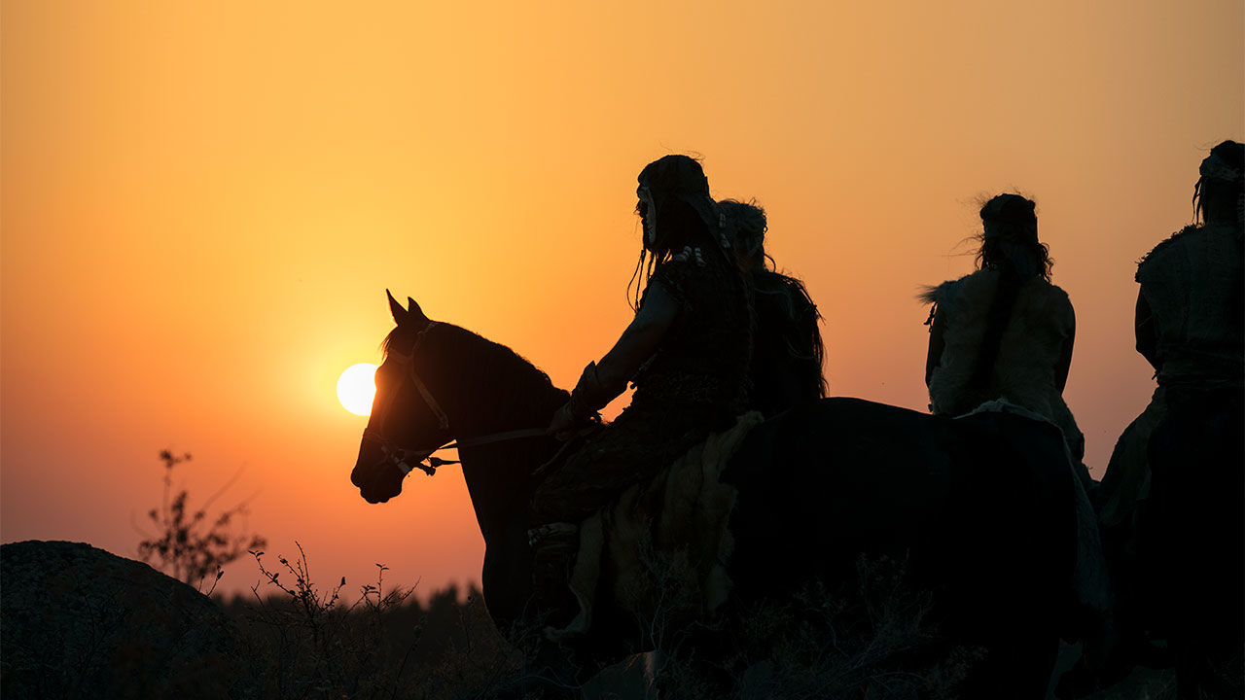
Horses and wheels
By the start of the Bronze Age, people in Britain had learned to tame horses. Then, around 1000BC, they learned to make carts with wheels. Some farmers travelled on horseback or used wooden carts, pulled by horses or oxen.
The first war chariots appeared at the end of the Bronze Age. Warriors rode into battle, standing on chariots pulled by horses.

Slide 9
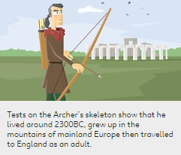
The Amesbury Archer
In 2002, archaeologists at Amesbury in Wiltshire made an amazing find. They discovered the grave of a Bronze Age man, just two miles from Stonehenge.
He was buried with around 100 objects! The people who buried him likely believed that he would use the objects in the next world. We can use the objects discovered to find out more about life in the Bronze Age.
When the man was found, he was nicknamed 'the Amesbury Archer'. This was because he was buried with arrowheads and wrist-guards used by archers.
The Amesbury Archer probably spent most of his time working with metal. One of the objects in his grave was a cushion stone - a tool used by metalworkers.
Explore this interactive picture of the Amesbury Archer’s burial finds: https://www.bbc.co.uk/bitesize/articles/zh3qmfr#:~:text=Trading%20ships%20travelled%20to%20mainland,known%20as%20the%20Bronze%20Age. Scroll down the page.

Slide 10
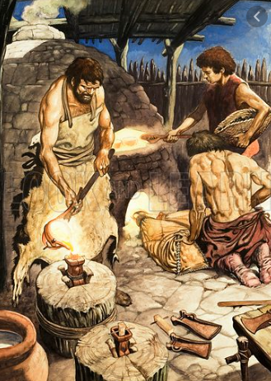
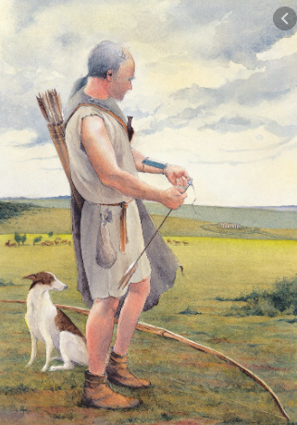
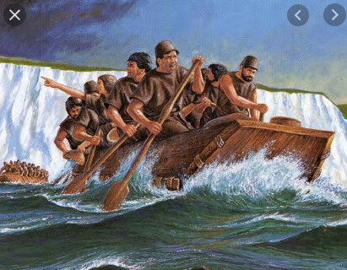
TASK
Draw a detailed Bronze Age scene.
Include the Amesbury Archer and the Dover Boat as they would have looked at the time.
Include other elements from your research that show how life was now different in the British Isles to what had come before.
Label your picture to explain each element you have included.

Slide 11
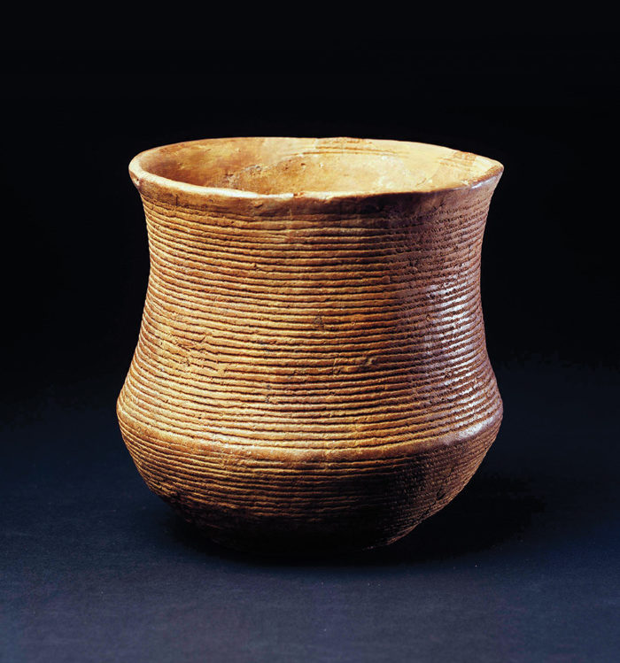
OPTIONAL TASK: Make your own Bell Beaker
If you have clay, you can have a go at making a bell beaker.
You can use a pinch-pot technique: https://www.youtube.com/watch?v=jjTJTfLsUis
Remember the shape you are aiming for.
And remember to decorate the pot before you leave it to dry.

