Slide 1
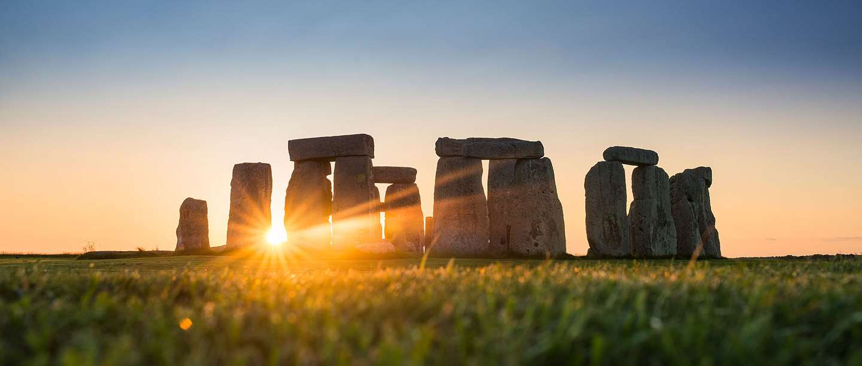
A time of great change: from the Stone Age to the Iron Age

Slide 2
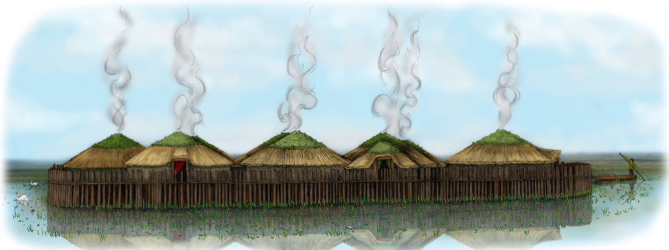
WEEK 9 Key Question: What happened at Must Farm?
LO:
To know that archaeological evidence can tell us about historical events.
To know what happened to the Bronze Age settlement at Must Farm
Skills Objective:
To use inference and archaeological evidence for a reconstruction drawing

Slide 3
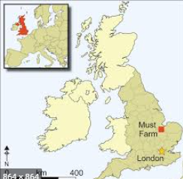
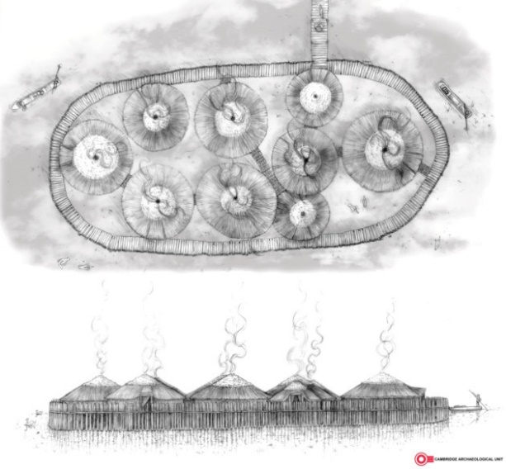
Where is Must Farm?
Not far away, near Peterborough in the fens is the remains of a Bronze Age settlement.
Until recently, no-one knew it was there and a farm had been built on the same site – the modern farm is called Must Farm.

Slide 4
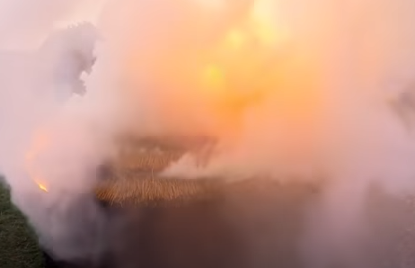
A devastating fire
Not long after it was built, the settlement at Must Farm burnt down.
The fire must have spread very quickly because the people didn’t have time to collect their possessions (this is good news for archaeologists because so much was left behind).
No bodies have been found at the site, so the people who lived there all managed to get to safety.
We don’t know if the fire was an accident or deliberate.

Slide 5
A village on stilts
We know that the settlement was built on stilts over a lake.
When the fire started, all the villagers’ things fell into the lake below and were lost.
They were buried in the soft mud at the bottom of the lake – this helped preserve them for thousands of years.

Slide 6
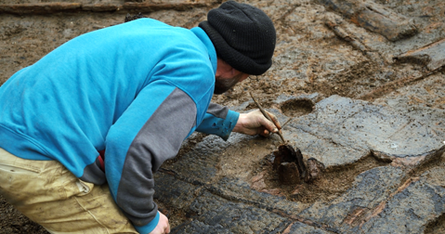
Use evidence to draw a reconstruction drawing.
Archaeologists create reconstruction drawings of sites and landscapes to help people understand what the results of their excavations mean. It can be hard to decode archaeological sites, so they interpret the evidence to create a drawing of what it might have looked like.
Looking at evidence from elements of the houses at Must Farm it’s possible to make ‘educated guesses’ as to what the houses originally looked like by looking at where the supporting posts were and what the walls and roof would have been made from. These ‘educated guesses’ are often called ‘interpretations’.

Slide 7
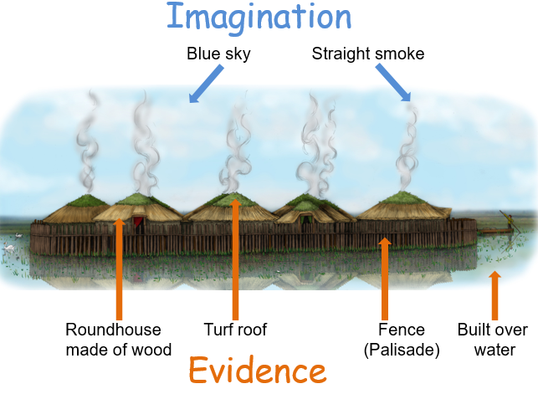
Some parts of this drawing are based on evidence but other parts are based on decisions made by the person drawing it. For example they have chosen to make the sky blue and have the smoke going straight up, making it a sunny day with no wind.
Other elements of the picture are based on evidence.

Slide 8
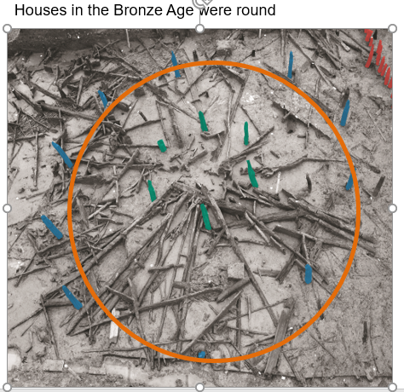
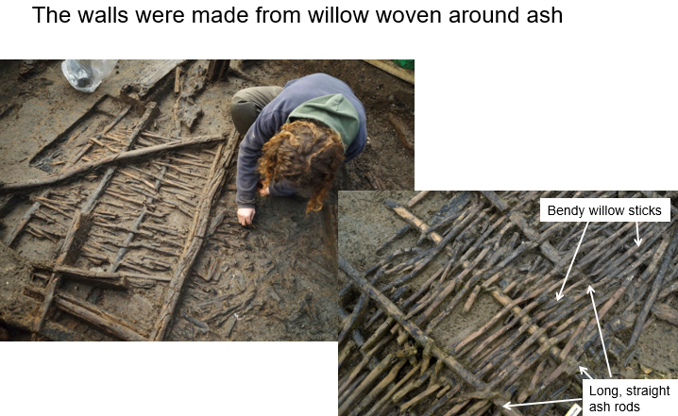
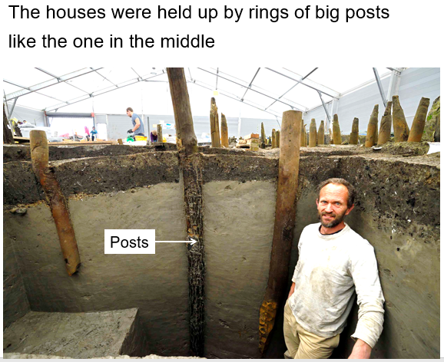
TASK: Use the evidence to draw a reconstruction drawing of the OUTSIDE of a roundhouse.
The posts still in the ground made a circle (they have been highlighted blue and green here).
This is called wattle. There was no clay on the sticks, so we don’t think they also used daub. The outside was probably just woven sticks.
The posts had been driven far into the ground, so they were able to support a very heavy load

Slide 9
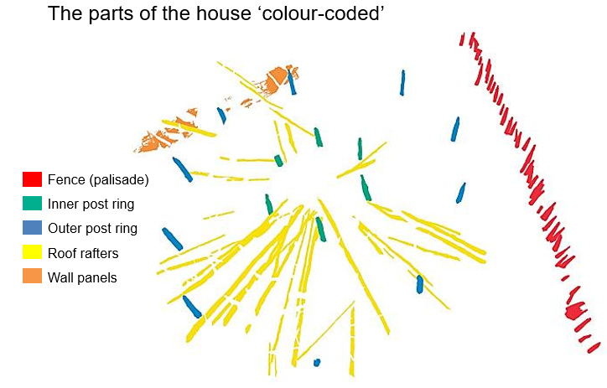
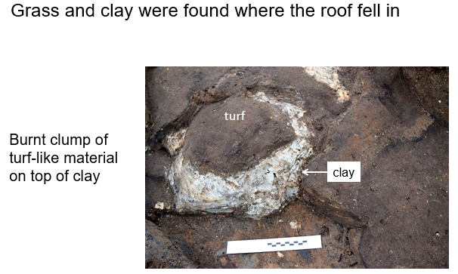
Evidence for the type of roof
Rafters are long poles that go fro the wall to the centre of the house for the roof. They made a cone shape. The bottom of the rafters hung out over the walls.
The archaeologists carefully recorded every piece of wood. Then they colour coded this map to show what they had found.
The archaeologists found evidence of thatching reeds, grass and clay. They think the grass was on the roof and held there with clay.

Slide 10
Evidence of other details to add
There was evidence that sheep were actually living inside the houses. Some archaeologists think they might actually have lived on the grassy rooves of the houses!
There must have been dogs living at the settlement because many of the bones had been chewed by dogs.

Slide 11
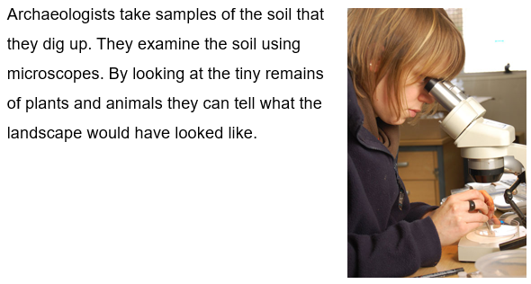
Evidence for the setting

Slide 12
Now draw your reconstruction drawing
You have all the evidence you need for your reconstruction drawing.
Remember, you are trying to draw what a Bronze Age roundhouse would have looked like from the outside in as much detail as you can.

Slide 13
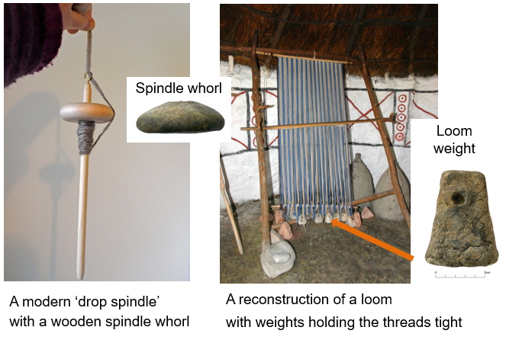
TASK: Use the evidence to draw a reconstruction drawing of the INSIDE of a roundhouse.
Every house had some evidence of spinning and weaving taking place. Textiles, loom weights and spindle whorls were found on site showing that spinning and weaving took place there.
These photographs show how the spindle whorls and loom weights would have been used to make the fabric that was found.

Slide 14
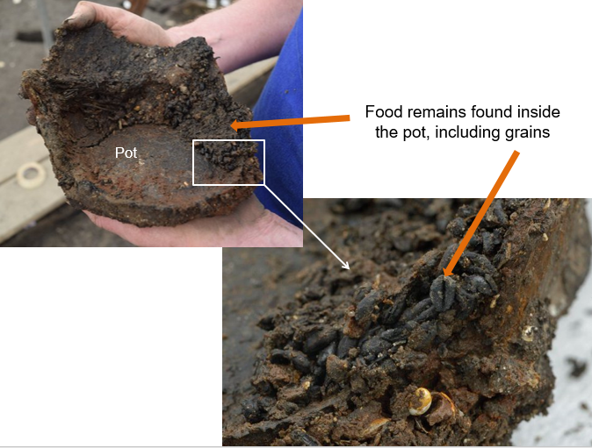
Evidence of food and cooking
Every house had some evidence of food storage. It is very rare to find whole pots from the Bronze Age, but at Must Farm there are lots – they must have fallen into the water during the fire, then gently sunk into the soft mud at the bottom of the lake.
Some of the pots still had food left in them when the houses burnt down. This included grains such as wheat and barley. Barley is still included in my recipes today, such as Scotch Broth or as a kind of porridge.

Slide 15
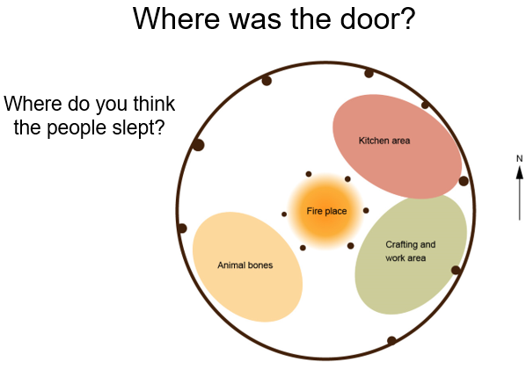
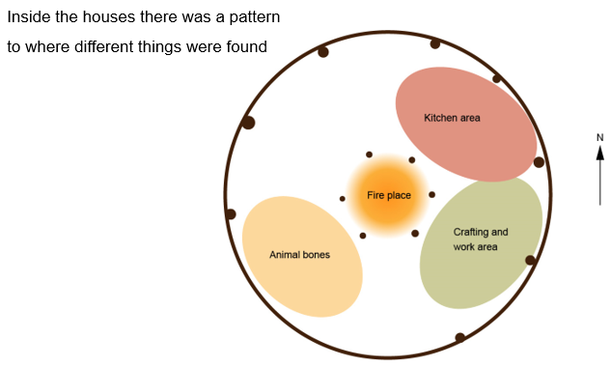
A pattern of finds
One mystery that remains is that we don’t know where the doors were. Which side do you think had the door?
Inside the houses there was a pattern to where different things were found. This made archaeologists think the houses were arranged into areas - a bit like we have rooms for different activities today.

Slide 16
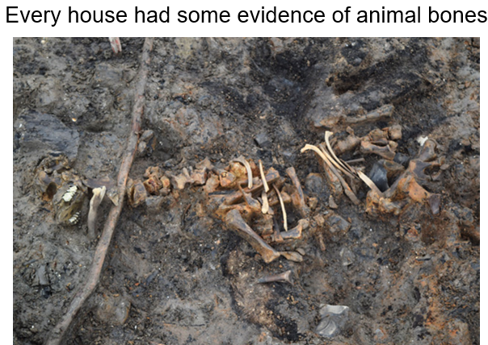
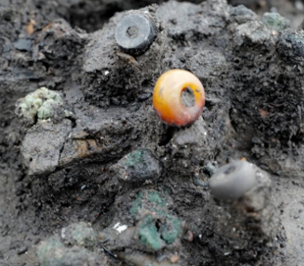
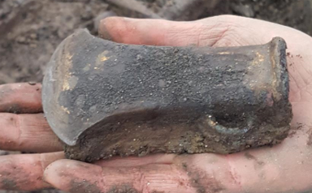
Other evidence
The bones of several animals were found. These animals were alive at the time of the fire, so they were probably living inside the buildings with the people but they were unable to get out when the fire struck
Beads
Lots of metal artefacts were found – axe heads, sickles, spear tips and more. These were in the houses too.

Slide 17
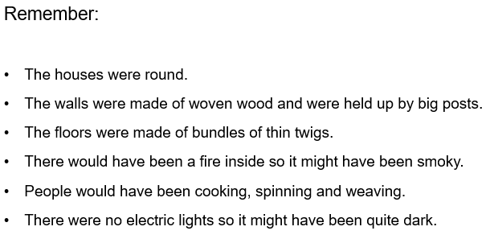
Now draw your reconstruction drawing.
You have all the evidence you need for your reconstruction drawing of the inside of a roundhouse.

Slide 18
ANSWERS
On the next page is a reconstruction drawing of a Must Farm roundhouse.
When you have finished your picture, look at this picture to see how another illustrator used the evidence to draw a reconstruction picture.
If you are still keen to find out more, there is a documentary here: https://www.youtube.com/watch?v=ShfJBBMOrik

Slide 19
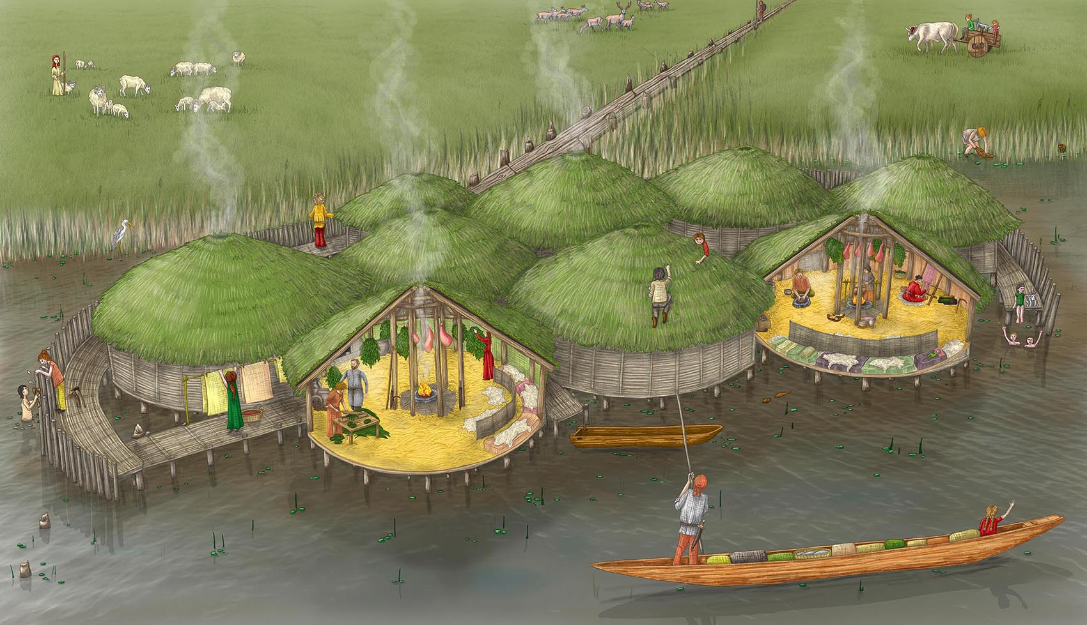
There is an interactive reconstruction here: https://www.vickiherring.com/archaeological-reconstruction/2019/5/10/2019/5/10/interactive-reconstruction

Slide 20
If you want to learn more about Must Farm, there are lots of brilliant resources here: https://historicengland.org.uk/services-skills/education/teaching-activities/must-farm-life-in-bronze-age-cambridgeshire/

