Slide 1
L.O. To analyse newspaper articles
Steps to Success
I can…
Identify the key parts of a newspaper articles (e.g. Layout and structure)
Identify language features (e.g. tense, punctuation and strategies)
C. Explore the use of grammar.

Slide 2
Using your newspapers, talk to your partner about these questions:
What is the purpose of a newspaper?
How is a newspaper set out?
What is the structure? (paragraphs?)
What questions is it answering?
What punctuation can you see?
Is there anything else you have noticed?

Slide 3
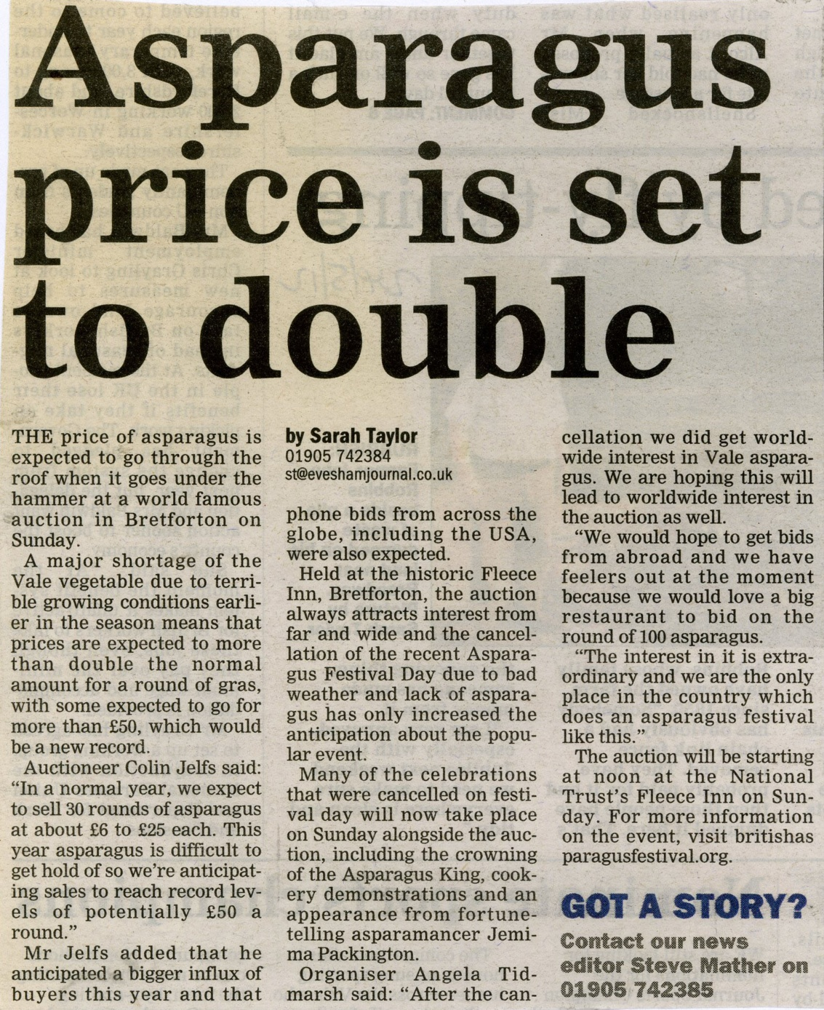
Layout of a newspaper
Who has written it (the journalist)
Contact information
Headline
Columns

Slide 4
Headlines
Short and to the point
Catchy
About the article (title)
Can be an alliteration
Interests the reader
Can have a play on words

Slide 5
Introduction/Opening
First paragraph
Will often answer all the 5Ws and H
What has happened?
When it happened?
Where it happened?
Who was involved?
Why it has happened?
How did it happen?

Slide 6
Main body
Will be the main part of the article.
Will often be more than one paragraph.
Explains and adds more detail about 5ws and H.
Can include quotations, photos and captions.

Slide 7
Summary/Conclusion
Will usually summarise/conclude what the article was about.
Will often tell us what is happening now, so will change from past tense to present tense.
May add some extra information or points of contact

Slide 8
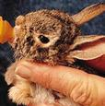
Photos
The photo shows us a snapshot of what happened, where it happened or who it happened to. It should make the reader “feel something” so that they want to read the article. If possible it should show action.

Slide 9
Caption
A caption goes underneath a photo to identify something or someone and to give us more information.
It is a label for the photograph!

Slide 10
In partners, choose a newspaper article and answer these questions:
Find the main body:
What else do you now know about this article? (Think Ws/H)
Were there any quotes?
What were the quotes?
Find any pictures:
What is in the picture?
What does the caption say?
Are there any adverts?
Find the headline:
What is the headline?
How many words are in it?
Who wrote this article?
Find the introduction:
What/who is the article about?
What happened?
When did it happen?
Where did it happen?

Slide 11
Plenary
Have we achieved the LO and SC?
LO: To analyse newspaper articles.
Success Criteria;
Identify the key parts of a newspaper articles (e.g. Layout and structure)
Identify language features (e.g. tense, punctuation and strategies)
C. Explore the use of grammar.
Questions
What is a headline?
What are the 5 w’s and 1 H?
Where will you find them in the Newspaper?
What is a caption?
What is the purpose of a newspaper?

Slide 12
L.O. To analyse newspaper articles
Steps to Success:
I can…
Identify the key parts of a newspaper articles (e.g. Layout and structure)
Identify language features (e.g. tense, punctuation and strategies)
C. Explore the use of grammar.

Slide 13
Questions
What is the purpose of a newspaper?
How is it set out?
What comes first/last?
What is a headline?
What does it use?
Think of an example,
What are the 5 w’s and 1 H?
Where will you find them in the Newspaper?
What is a caption?

Slide 14
Language analysis
What tense is most of the newspaper in?
Does it use lots of complicated words and sentences?
Does it use shortened synonyms?
Does it use facts?
Does it use opinions?
Does it use rhetorical questions?
What type of punctuation does it use?

