Slide 1
Education Pack
Introduction

Slide 2
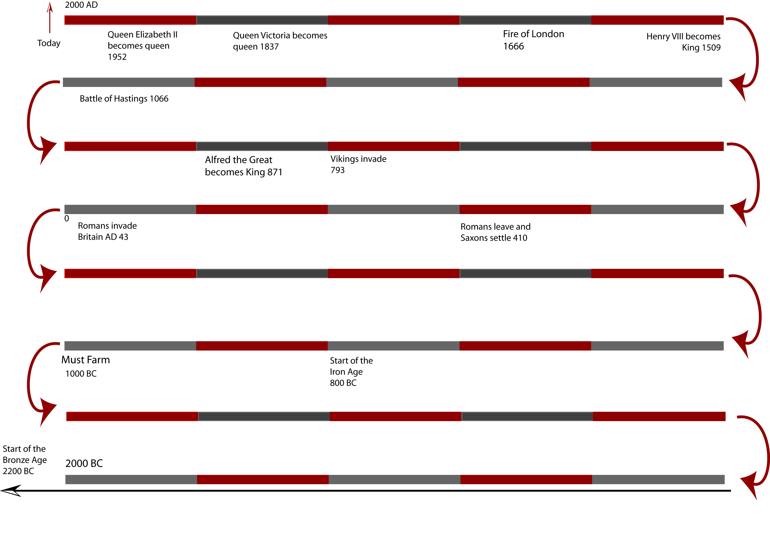
Notes:
Timeline showing Must Farm around 1000BC. The scientific dating programme from the excavation has since suggested that the houses were actually only lived in for around a year at some time in the 9th century BC.

Slide 3
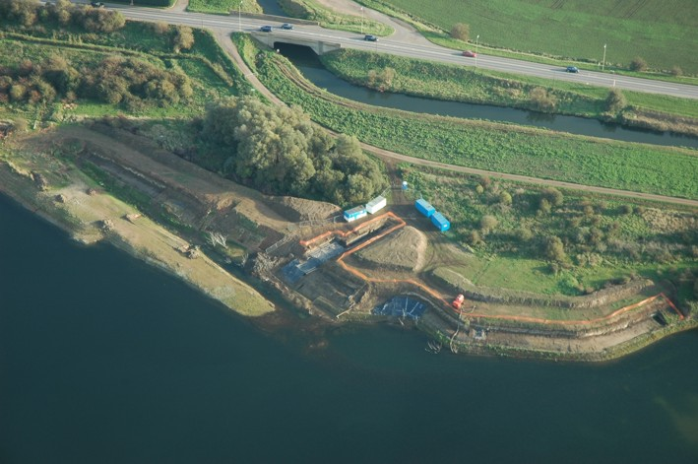
Notes:
This is a photograph showing where the site was.

Slide 4
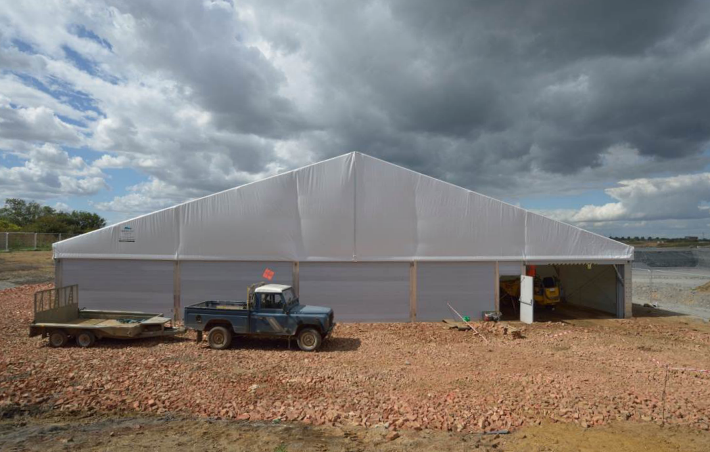
Notes:
A temporary building was put up to allow the archaeologists to work throughout the winter and to protect the delicate archaeological site as it was uncovered.

Slide 5
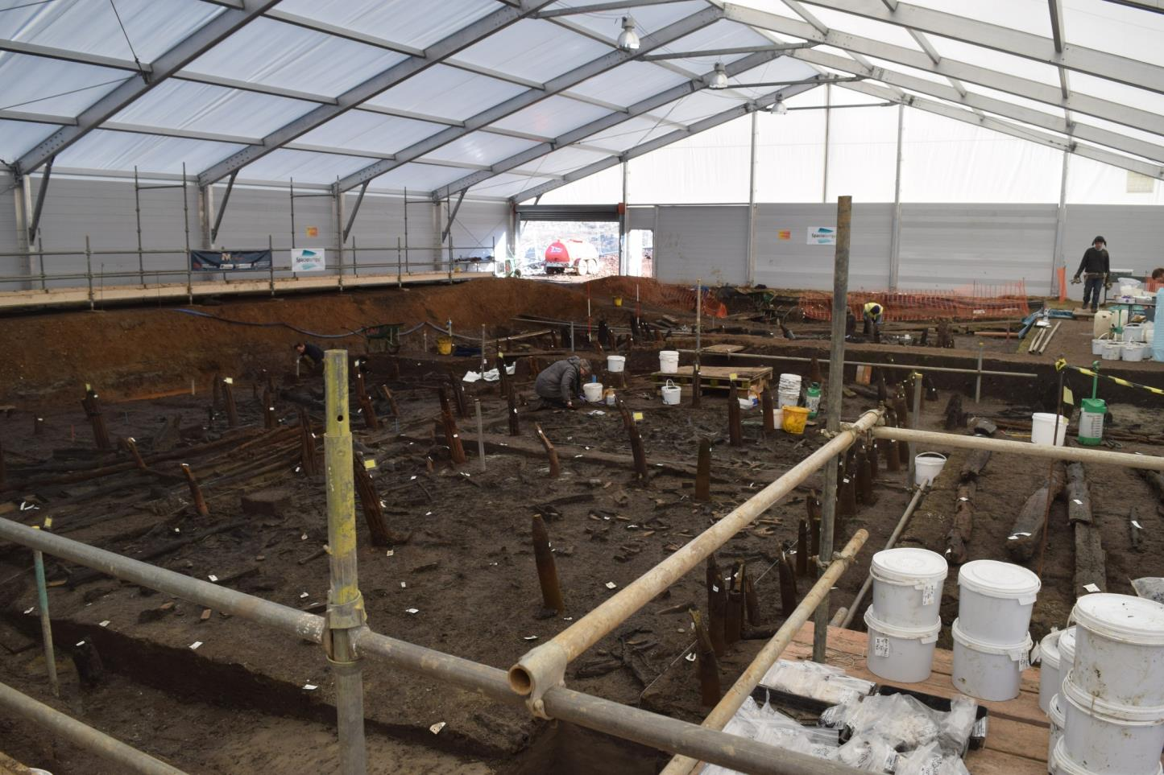
Notes:
Inside the temporary building

Slide 6
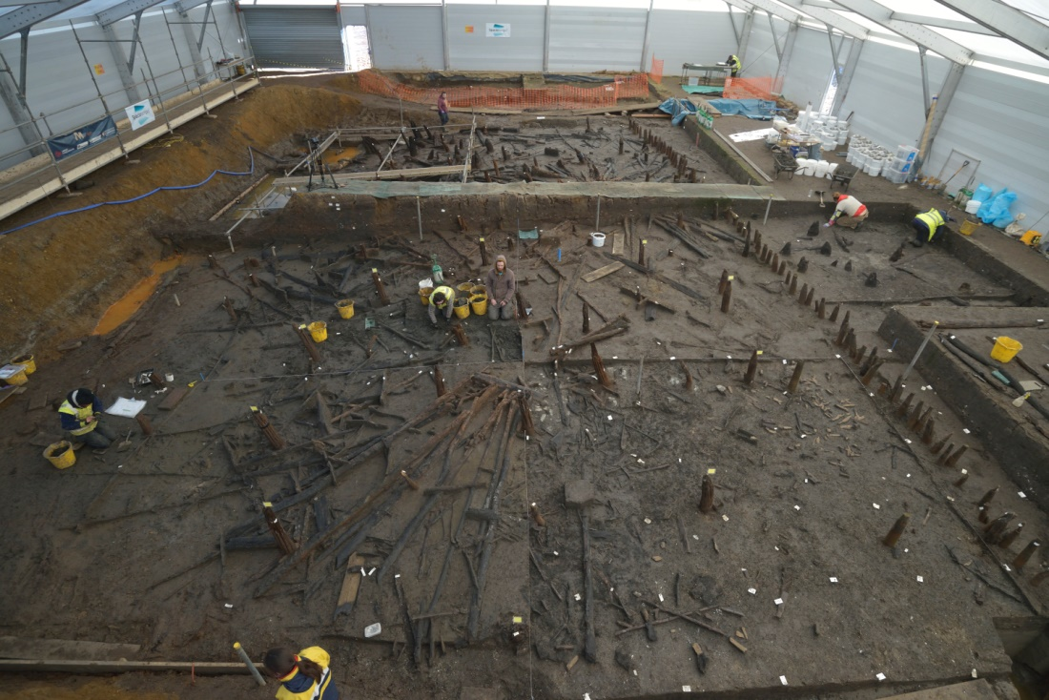
Notes:
An overhead view of Must Farm. The remains of houses are in the main part of the picture with a row of uprights forming the palisade which surrounded the site visible on the right hand side. In the middle right had side where two people are working you can see the top of some posts which formed an earlier causeway.

Slide 7
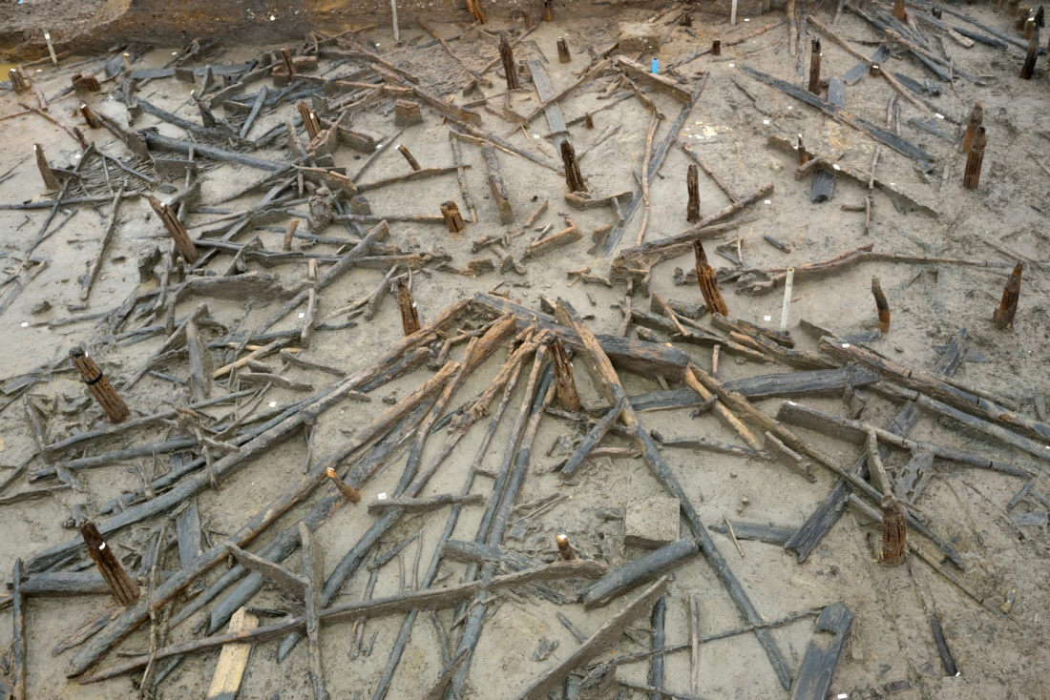
Notes:
What’s left of one of the houses at Must Farm

Slide 8
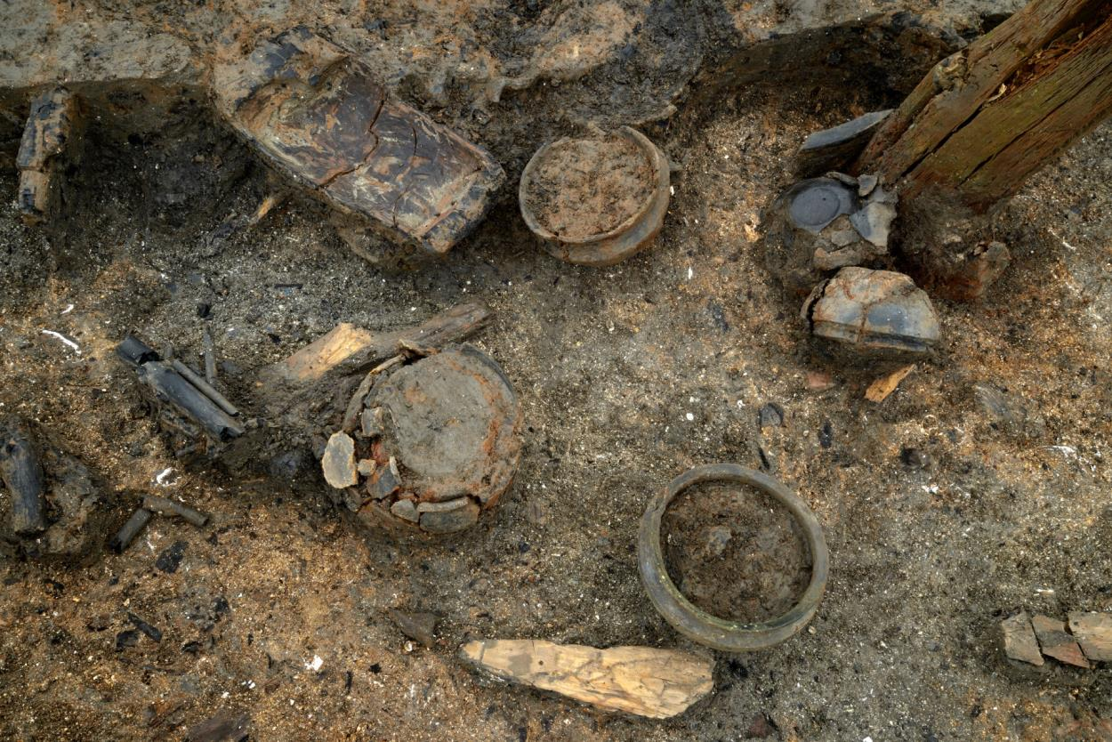
Notes:
When the houses burnt down their contents fell through the floor and landed on soft river silts

Slide 9
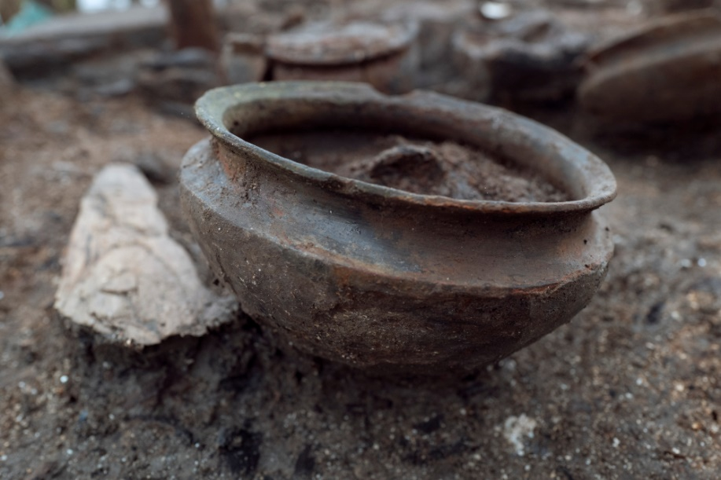
Notes:
One of the complete pots

Slide 10
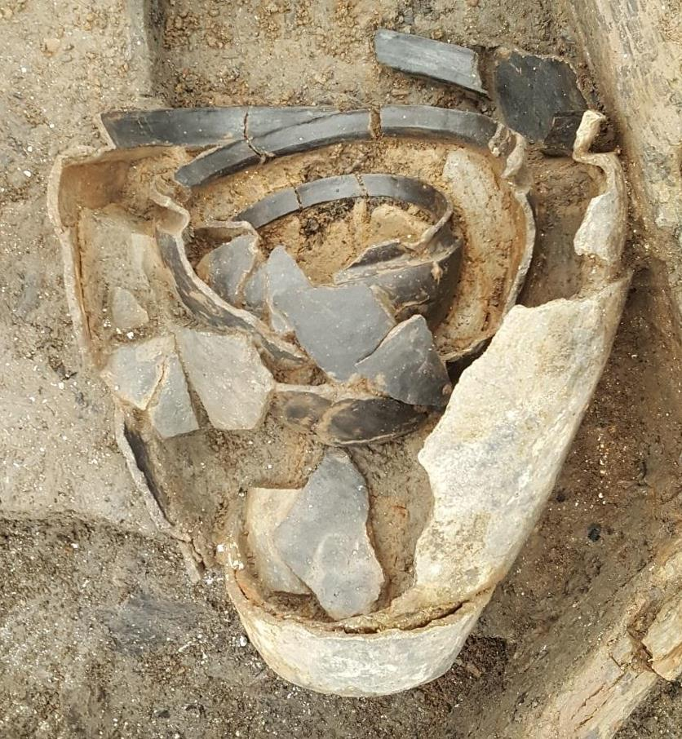
Notes:
A ‘nest’ of pots

Slide 11
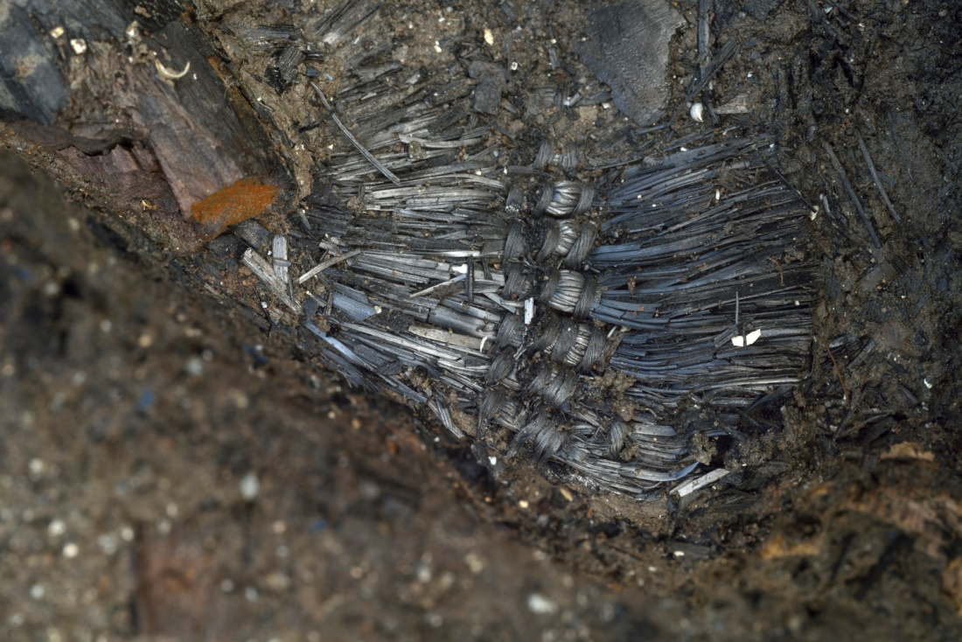
Notes:
Surviving textiles

Slide 12
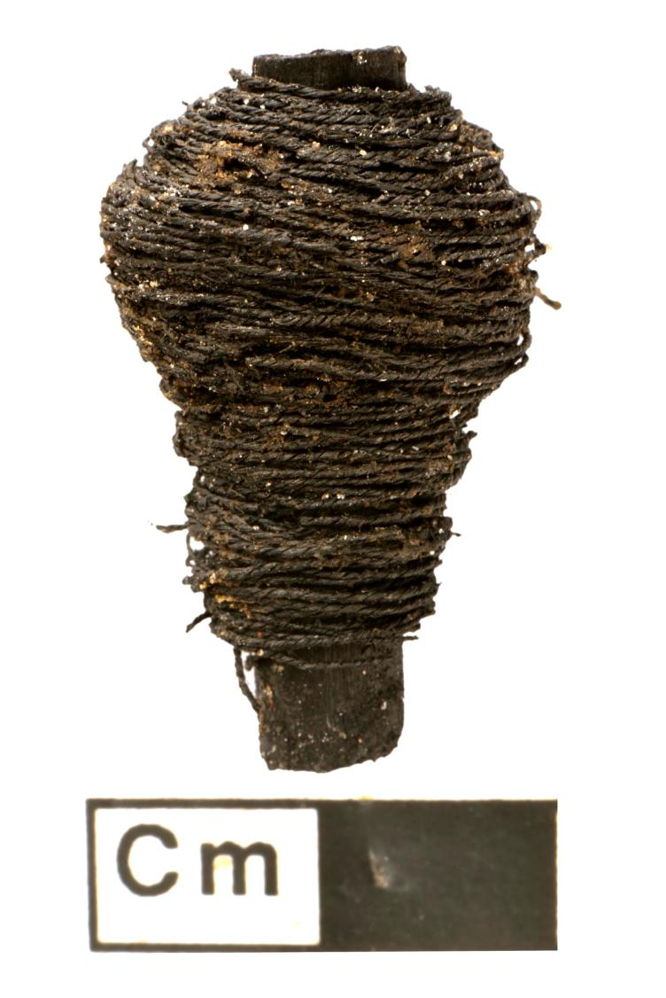
Notes:
A bobbin

Slide 13
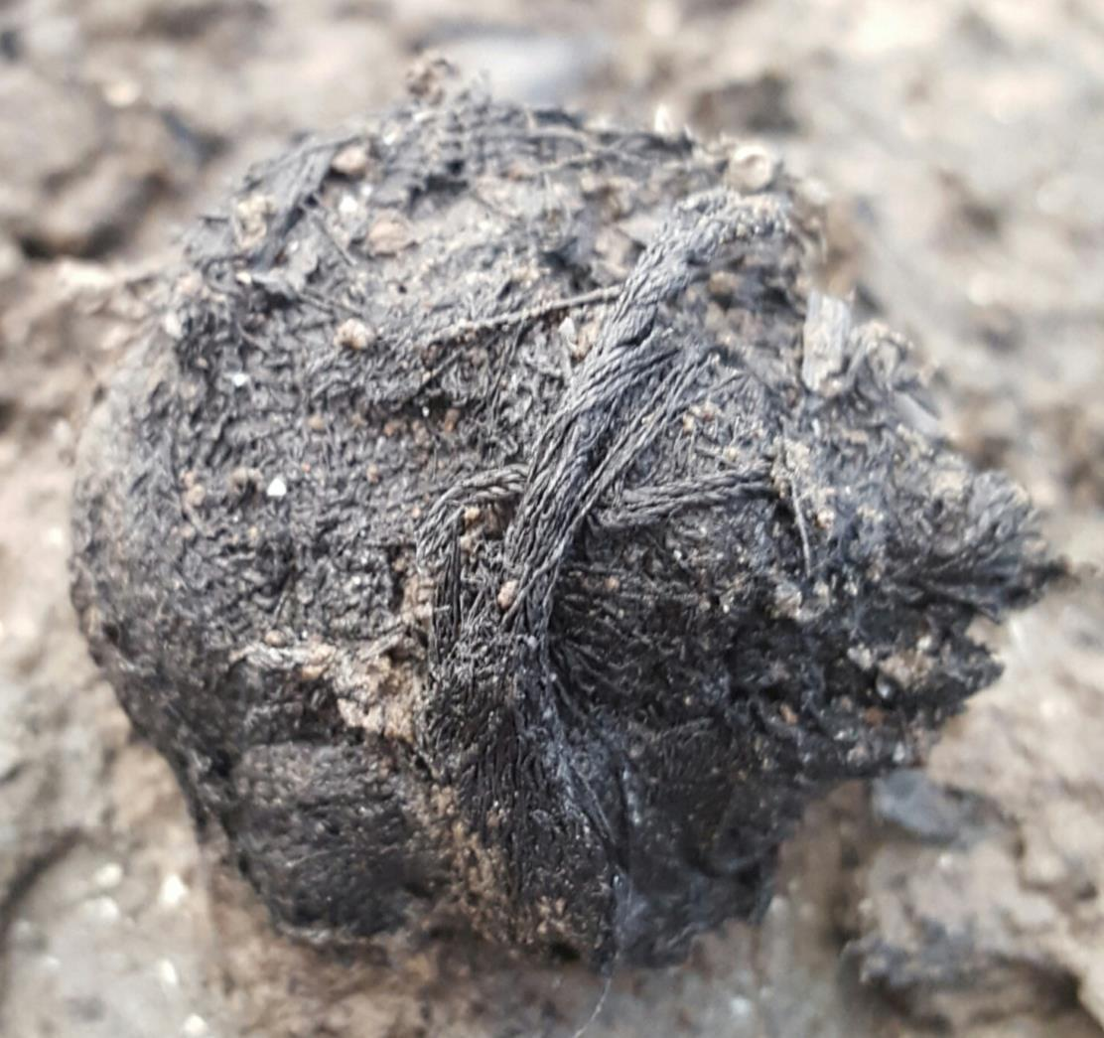
Notes:
Twine made from nettles

Slide 14
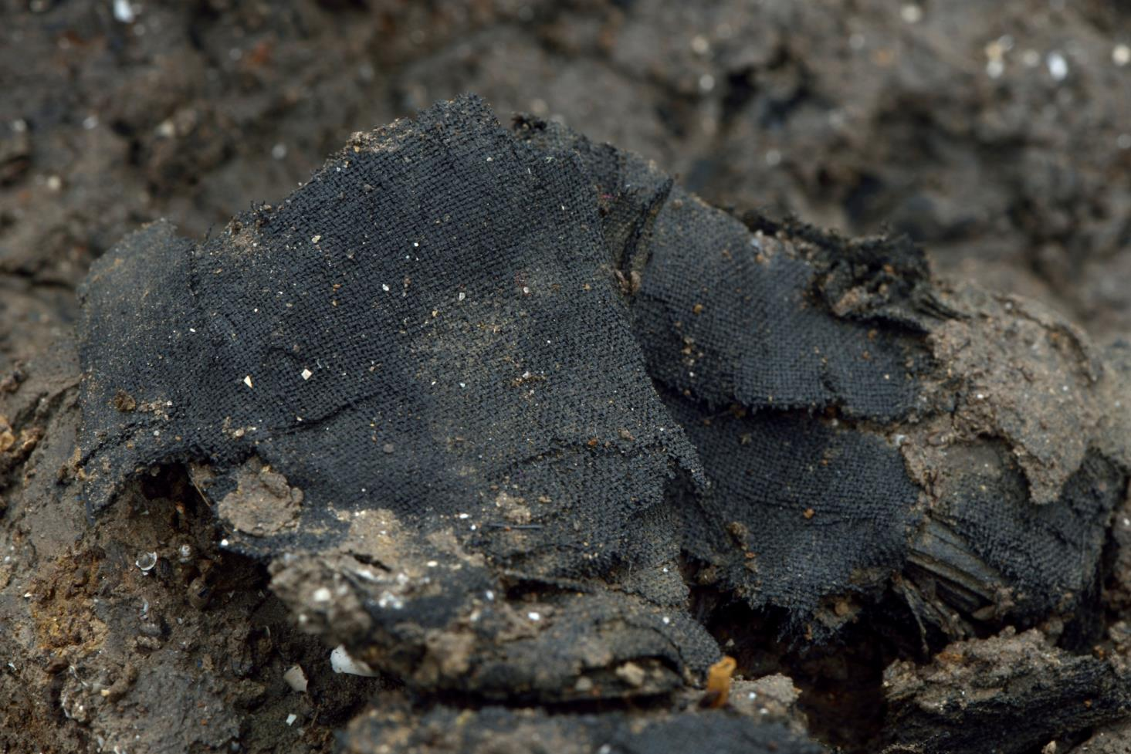
Notes:
Fabric made from plant material

Slide 15
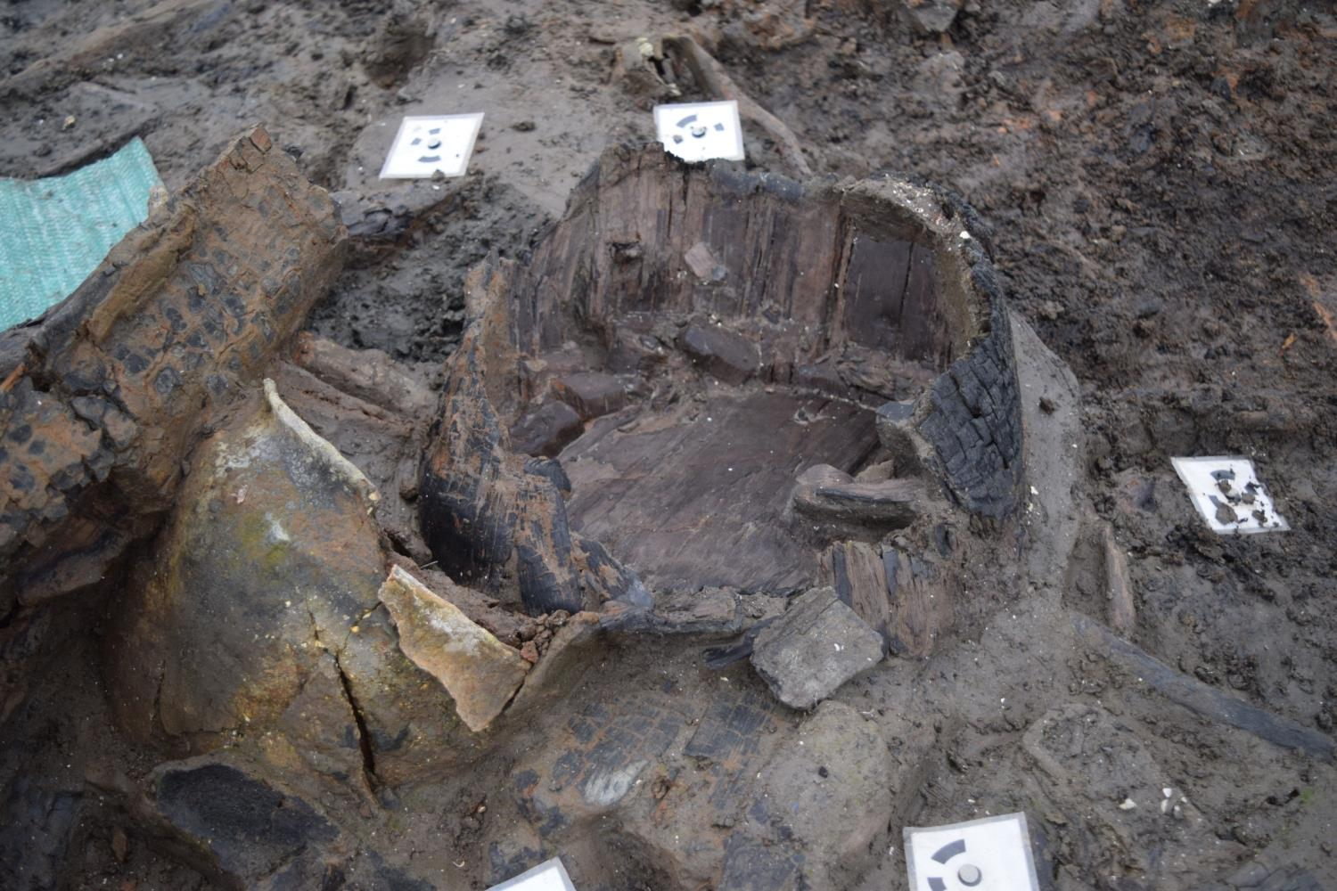
Notes:
A wooden bucket. This probably contained water as the outside is burnt but the inside isn’t suggesting that it was protected by liquid.

Slide 16
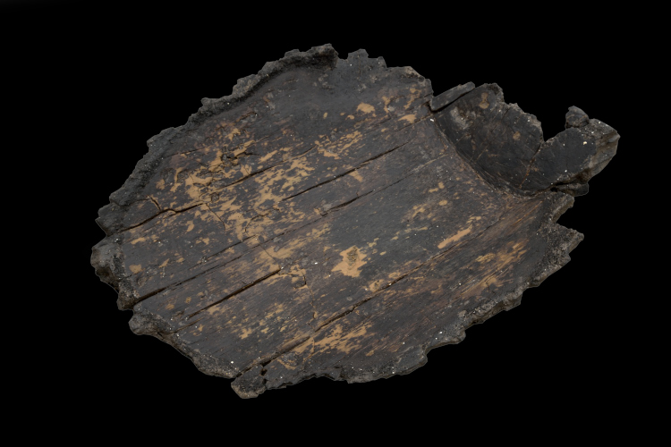
Notes:
Part of a wooden bucket

Slide 17
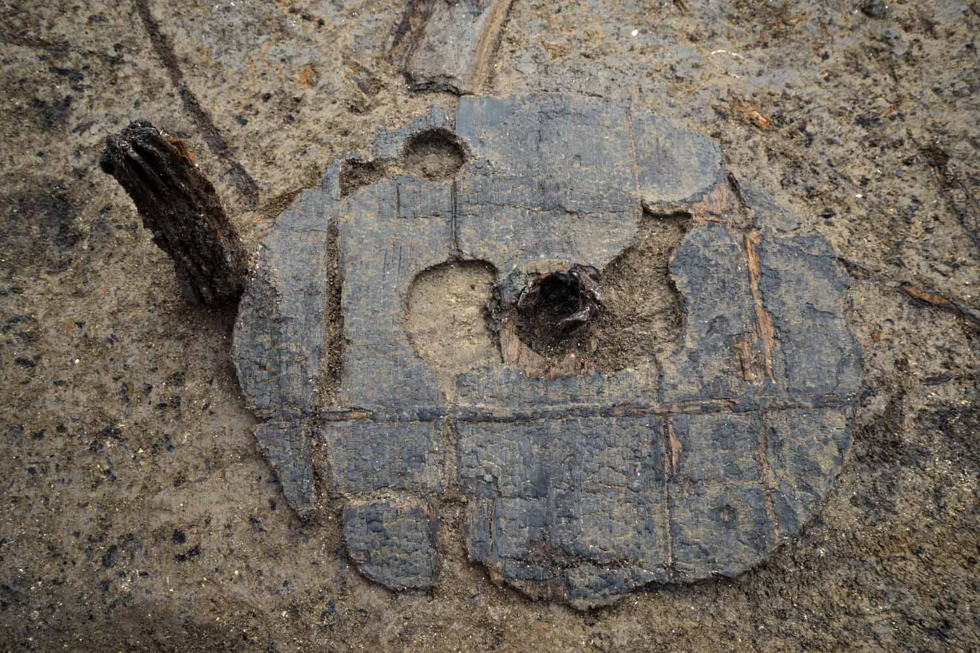
Notes:
The earliest complete wheel found in Britain

Slide 18
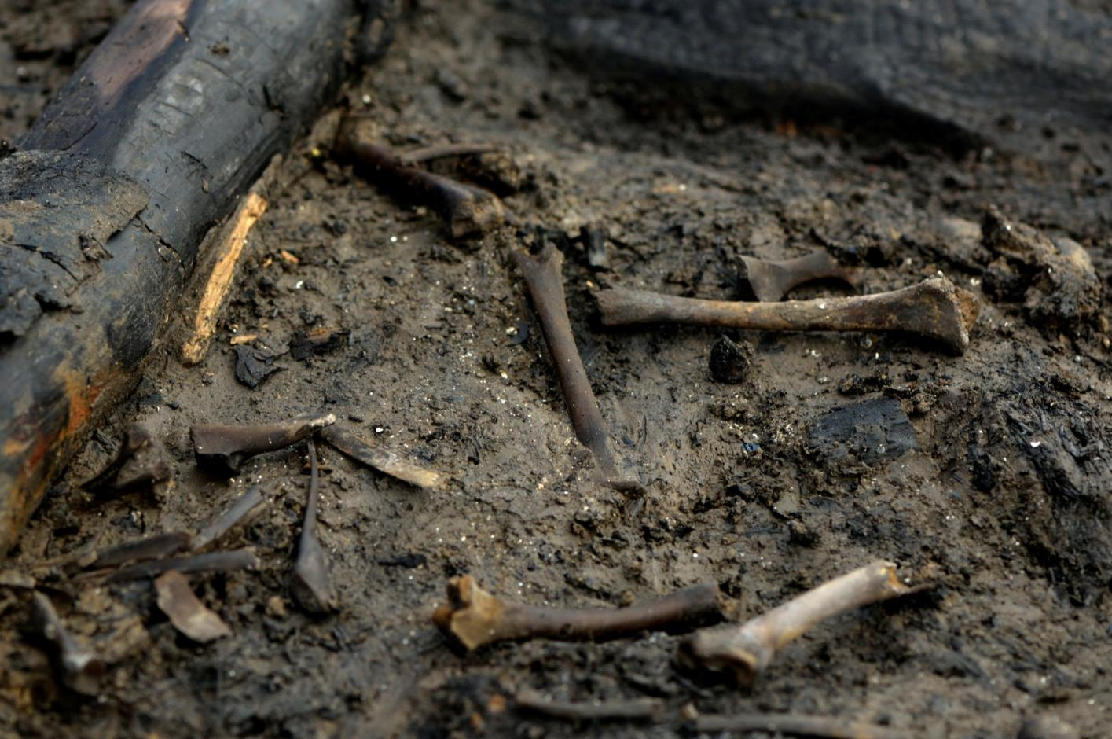
Notes:
Lamb bones

Slide 19
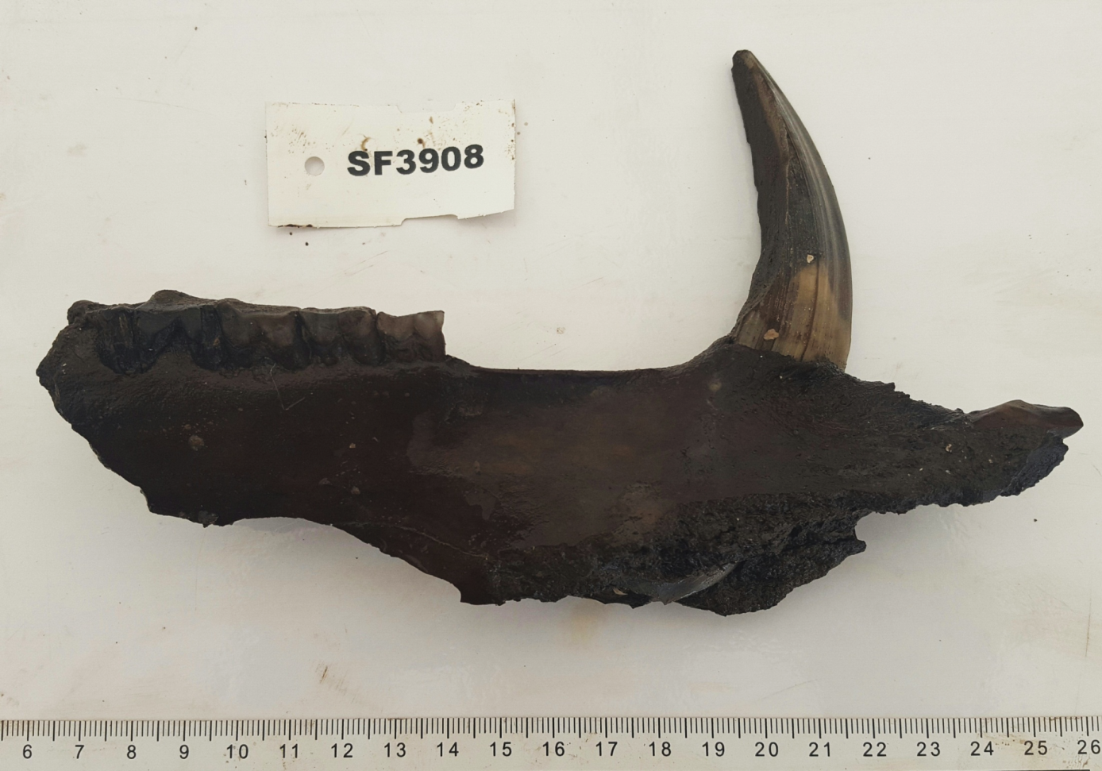
Notes:
A wild boar jaw

Slide 20
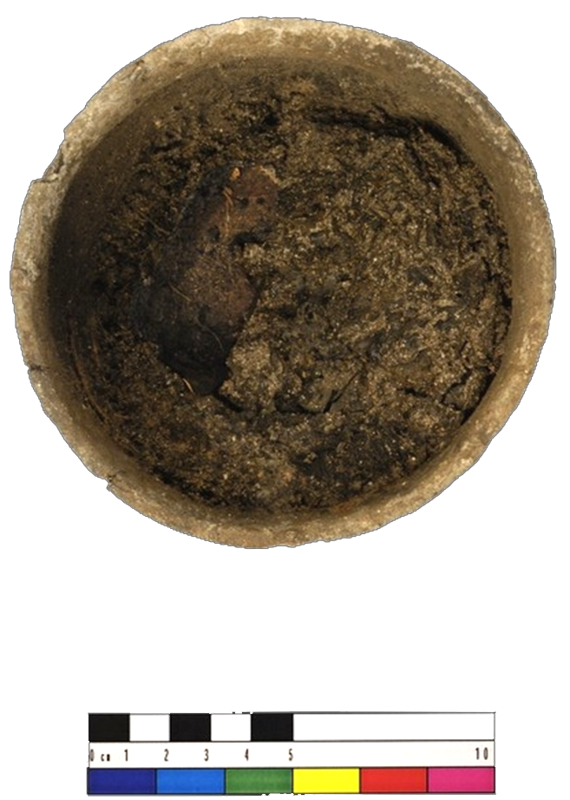
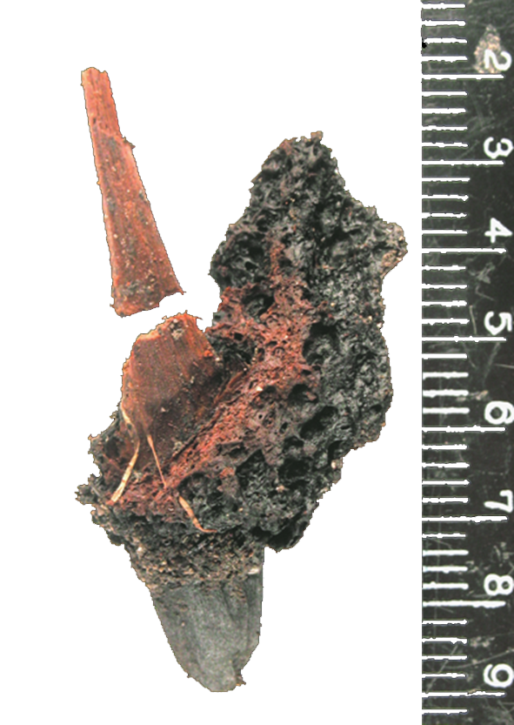
Notes:
20
A pottery bowl and spoon with remains of food

Slide 21
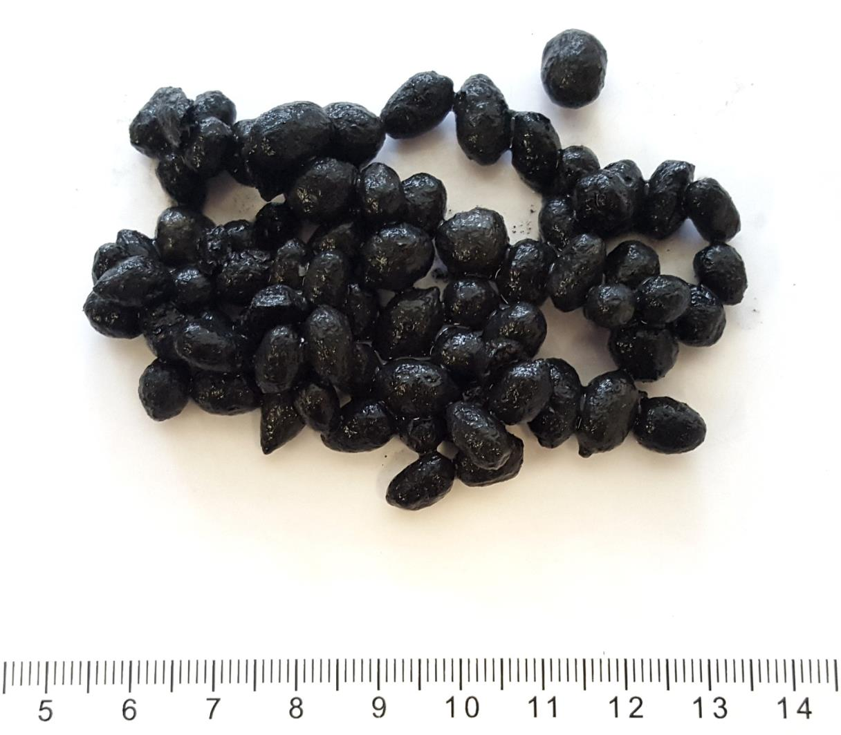
Notes:
Sheep droppings

Slide 22
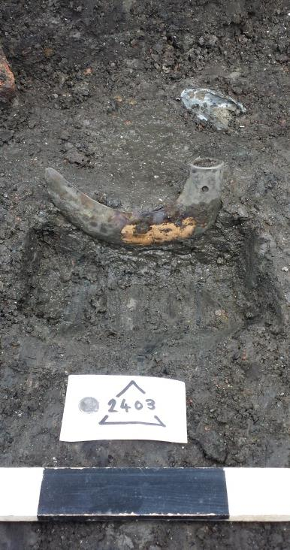
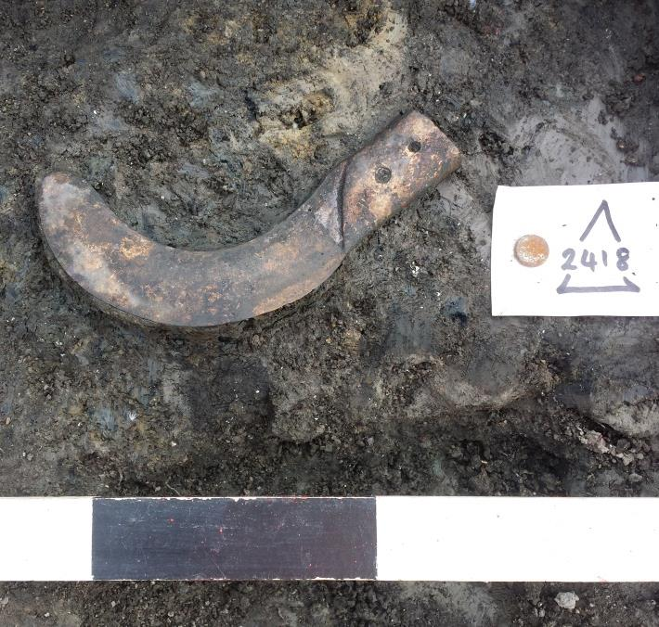
Notes:
A sickle

Slide 23
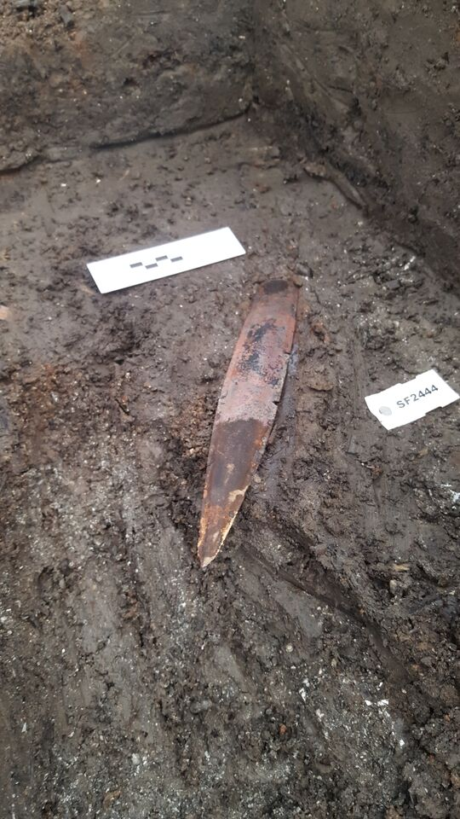
Notes:
A rapier

Slide 24
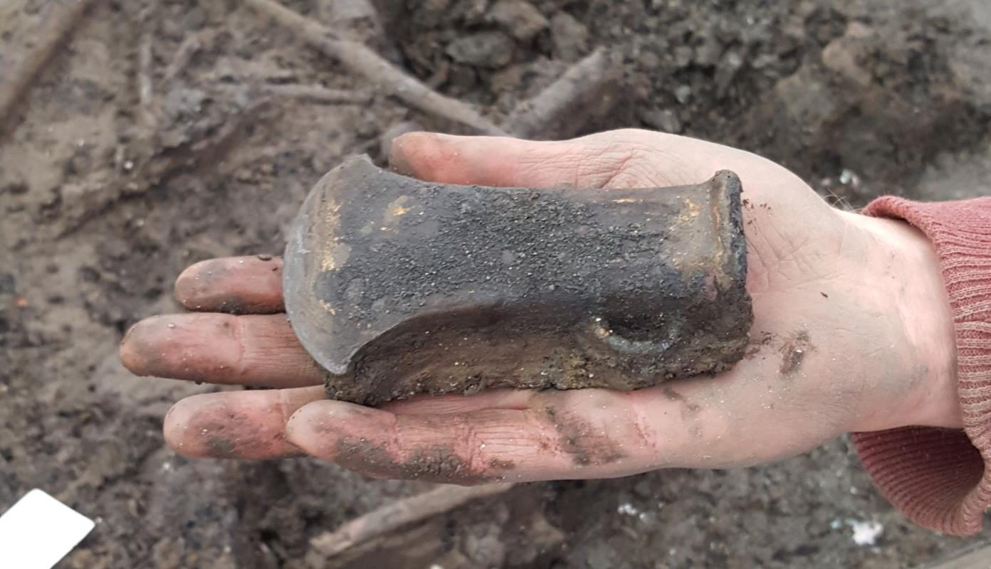
Notes:
An axe

Slide 25
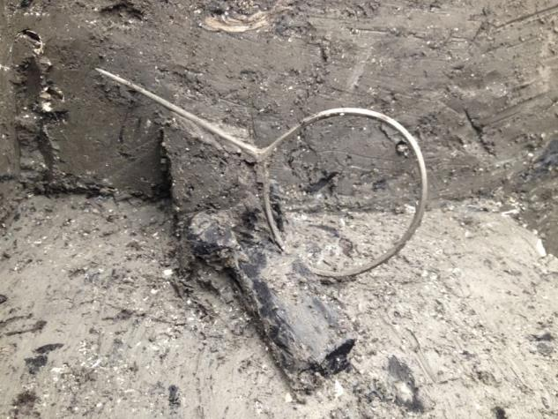
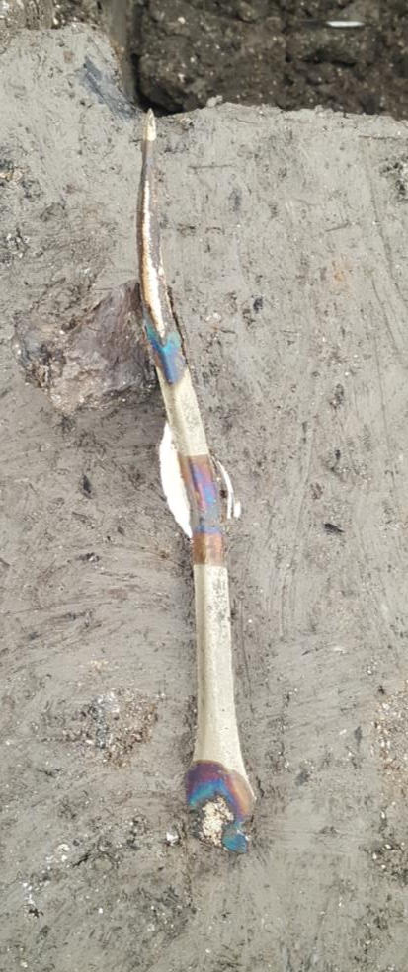
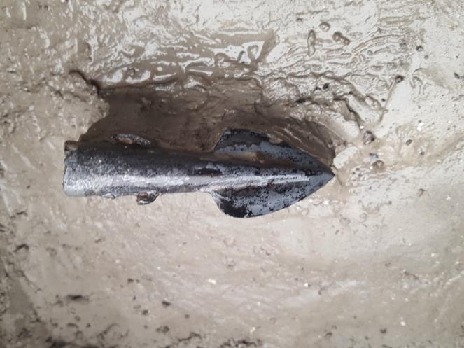
Notes:
A rapier, a bronze pin and a spearhead

Slide 26
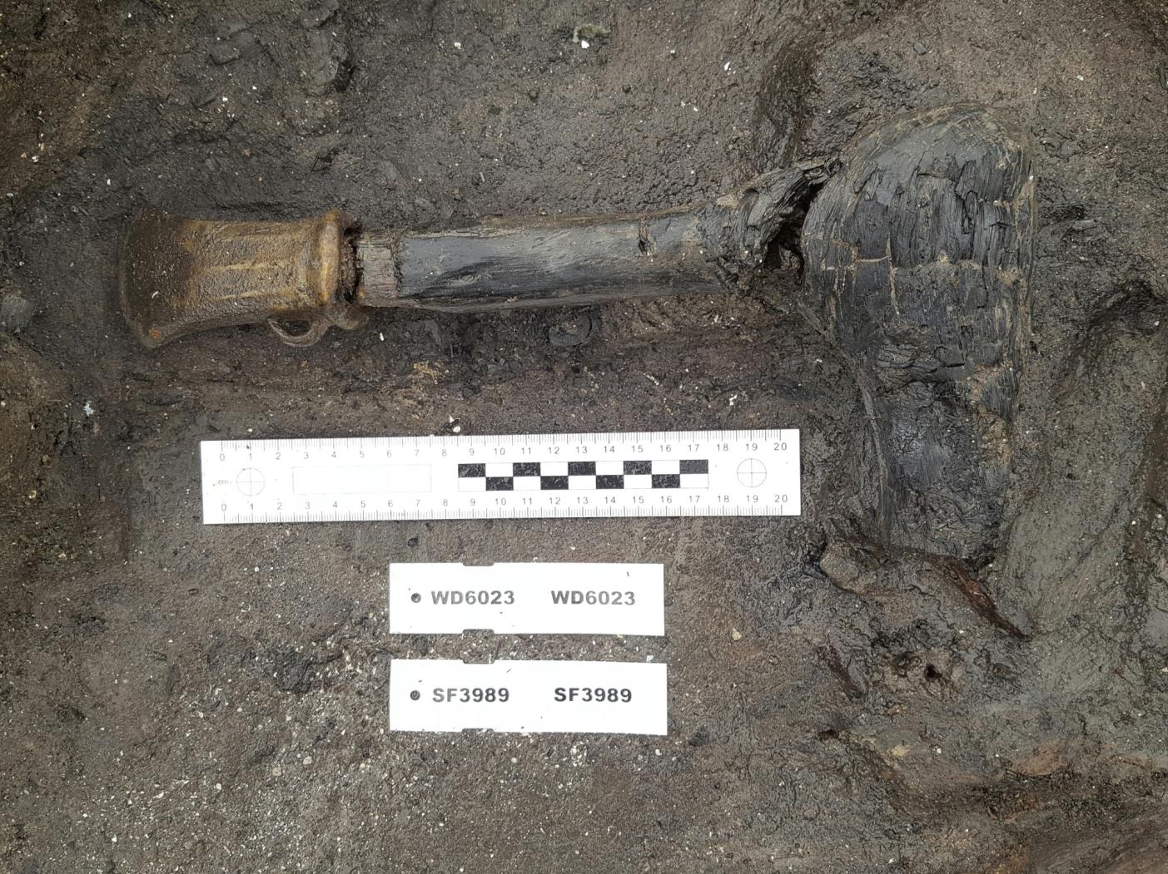
Notes:
An axe with its handle still attached

Slide 27
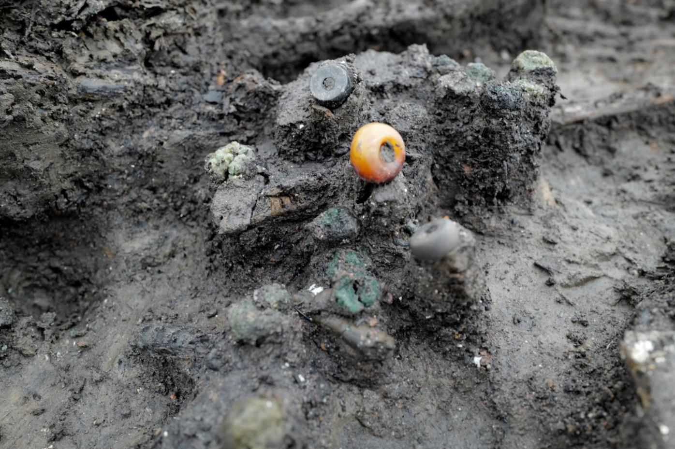
Notes:
Beads

Slide 28
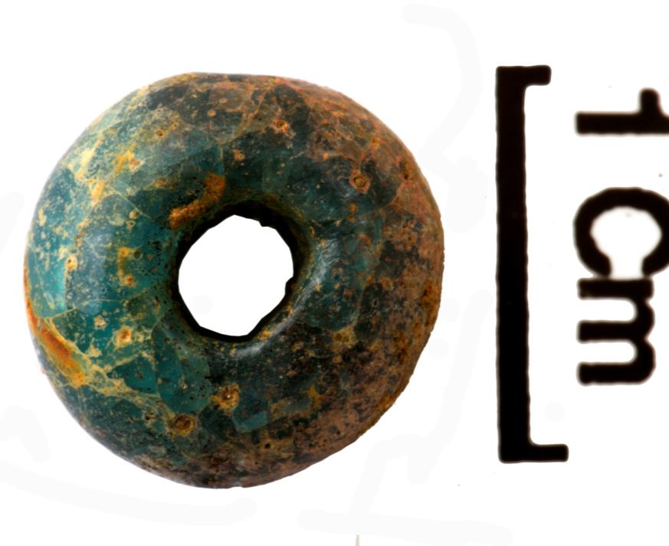
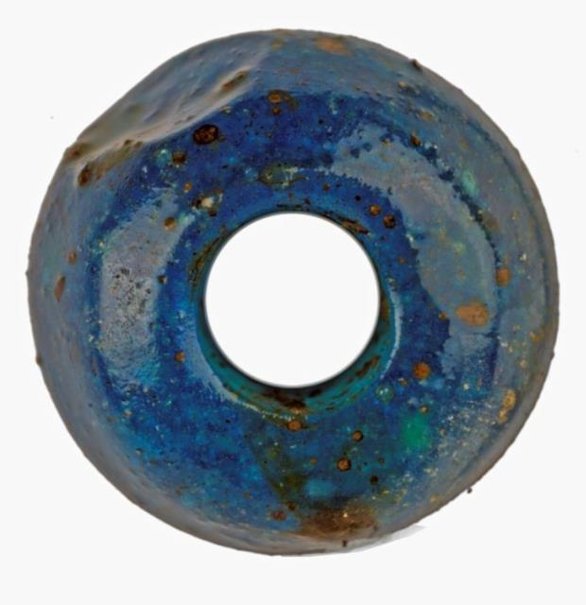
Notes:
Beads

