Slide 1
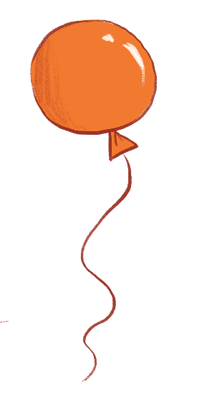
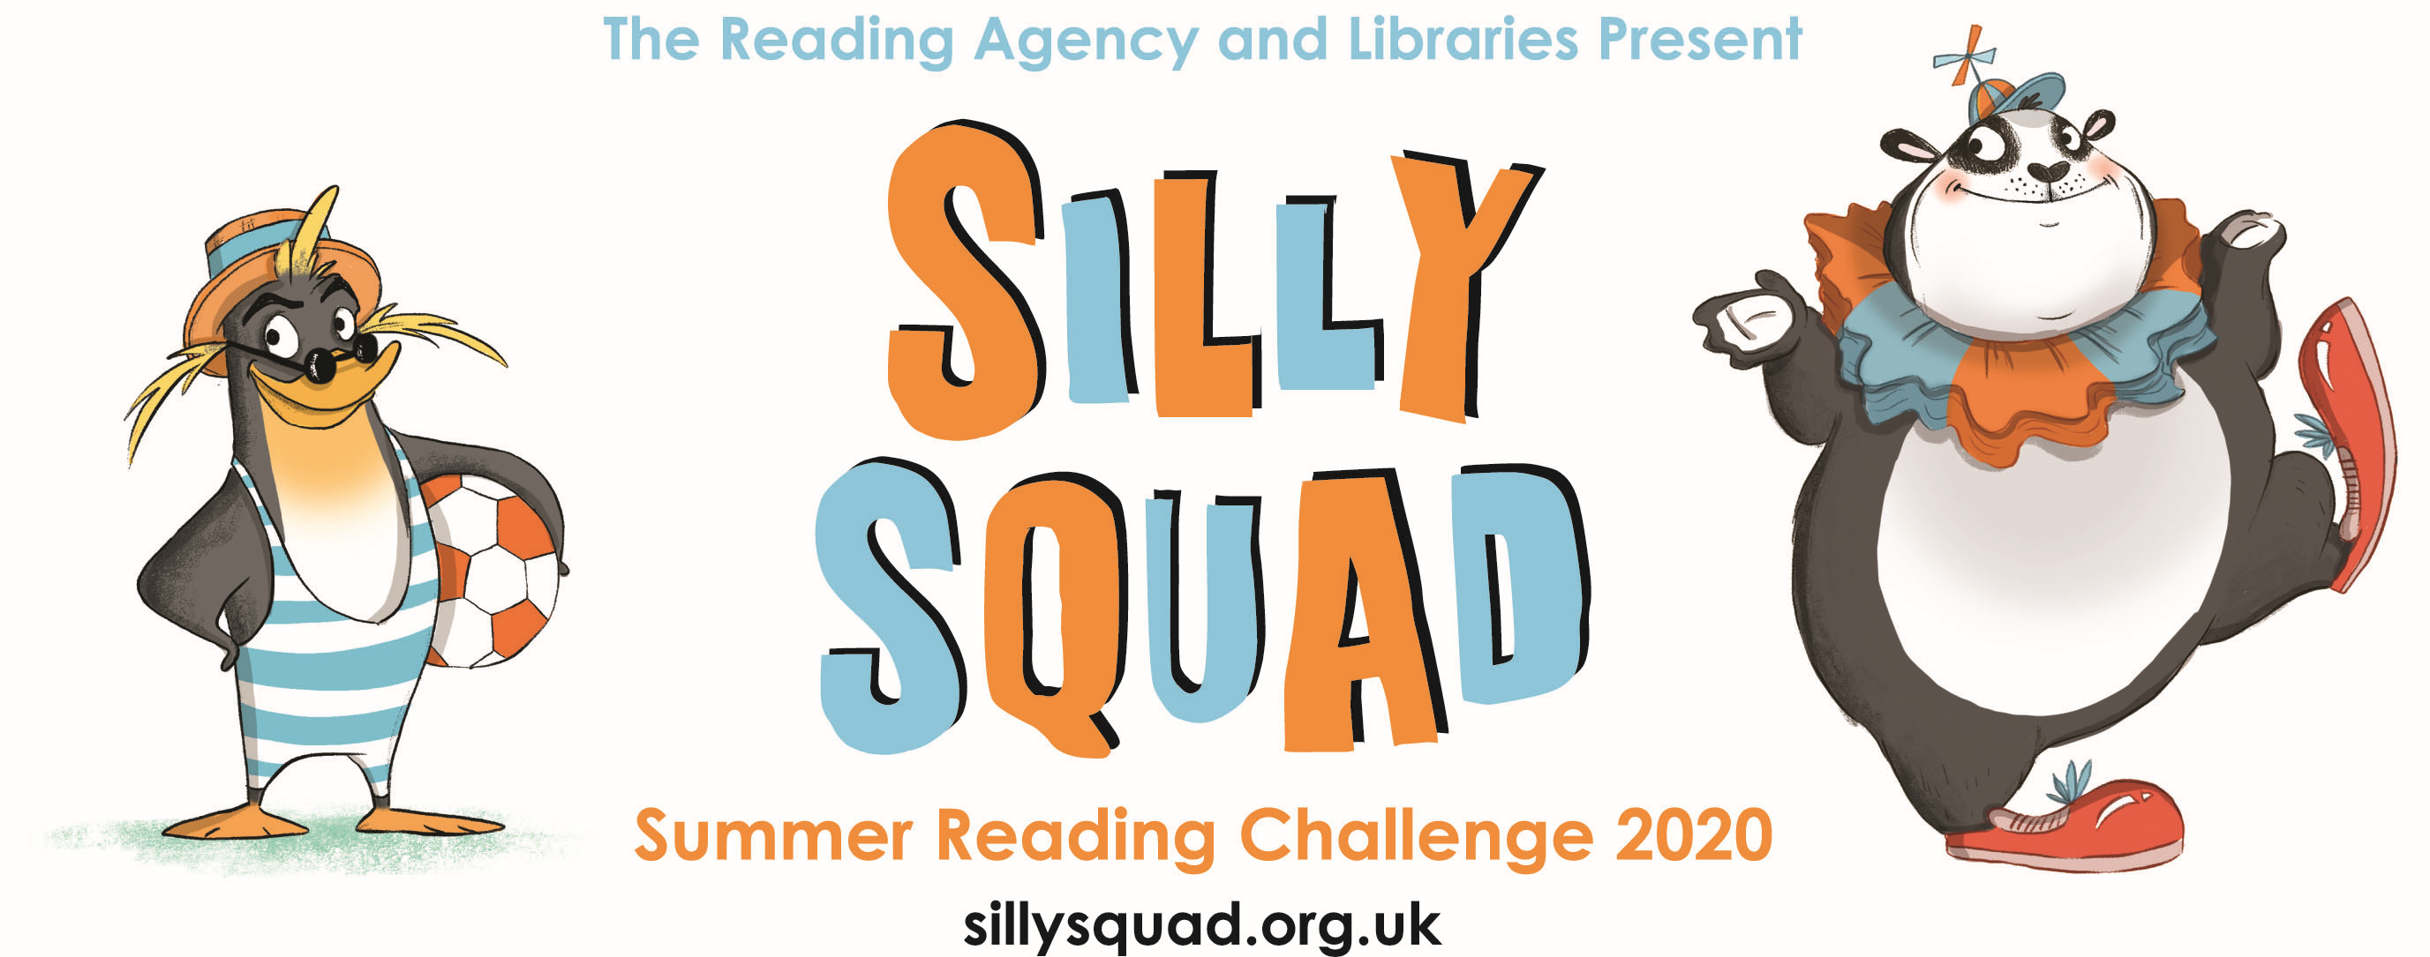
sillysquad.org.uk
Illustrations © Laura Ellen Anderson 2020 for The Reading Agency
Notes:
Please customise, add or remove slides and information to reflect how your school/class can take part in the Summer Reading Challenge.
Information for teachers
In 2019-20, The Reading Agency reached over 1.8 million people across the UK, including more than 950,000 children and over 900,000 adults and young people. Our largest programme is The Summer Reading Challenge that takes place every summer. Last year, 722,731 children took part in our Space Chase reading challenge. Due to Covid-19 and the ongoing social distancing measures in schools and public libraries, this year the Challenge will be digital and start on the 5 June! The Summer Reading Challenge is an annual event aimed at 4-11 year olds. Every summer holiday, children are encouraged to read six (or more) books of their choice with collectable incentives and rewards, plus a certificate for every child who completes the Challenge.
The artwork included in this PowerPoint can only be used to promote and support the Summer Reading Challenge 2020. The artwork should not be extracted or adapted.
Who has taken part in the Summer Reading Challenge before?

Slide 2
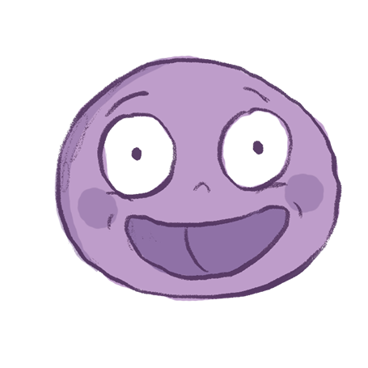
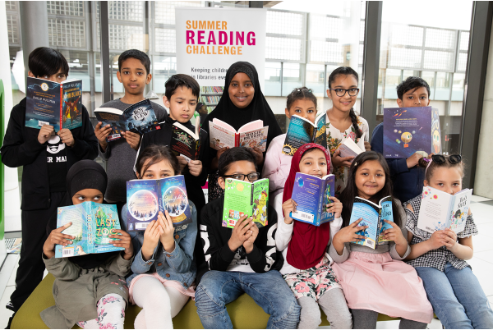
sillysquad.org.uk
Illustrations © Laura Ellen Anderson 2020 for The Reading Agency
Photographs © Dave Warren 2019 for The Reading Agency
Notes:
It’s free to join the Silly Squad website and take part in the Summer Reading Challenge 2020
Children will need permission from a parent/carer to complete the online registration
Children using the website choose a screen name and their personal details are never shared with other users on the site
All book reviews submitted to the site are checked by a moderating team before publication
All messages posted to the Chat page are checked by a moderating team before publication. Children cannot message each other independently of the moderated forum
As libraries make plans to reopen, The Reading Agency is working closely with partners to provide physical Summer Reading Challenge materials to local authorities, enabling them to reach children and families who may not participate online

Slide 3
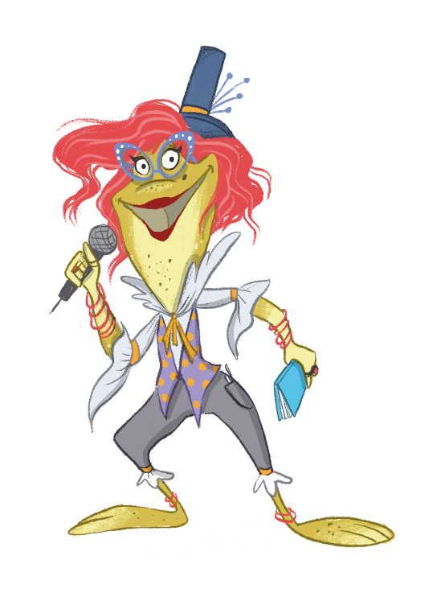
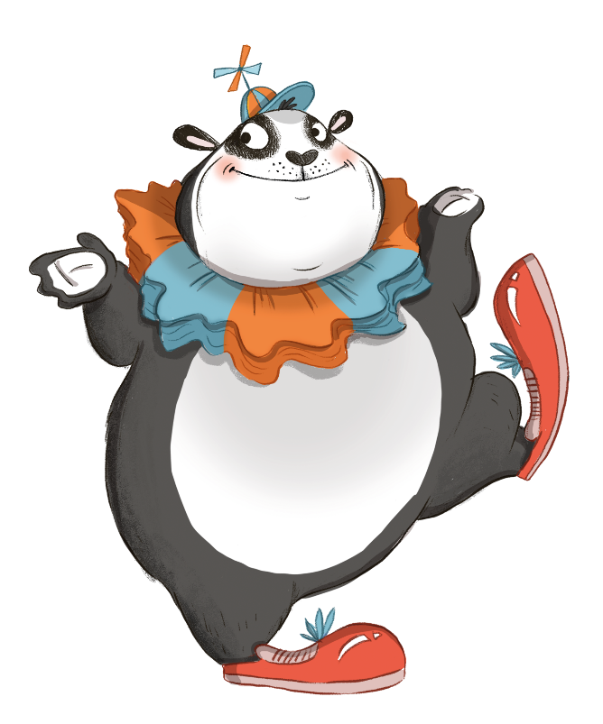
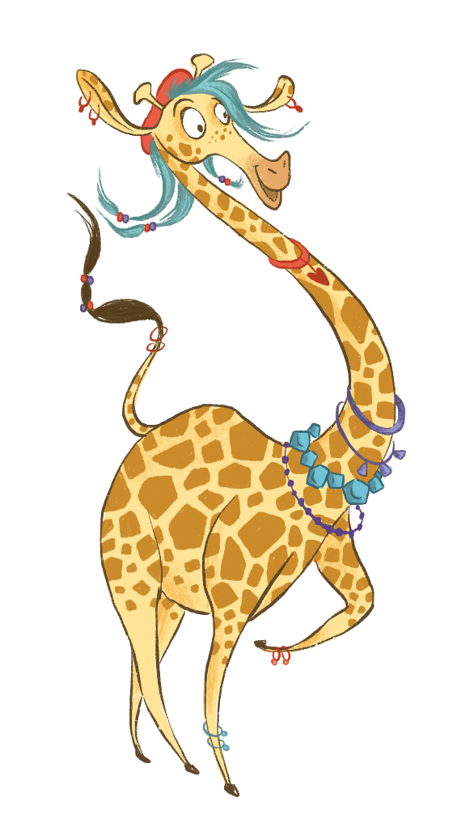
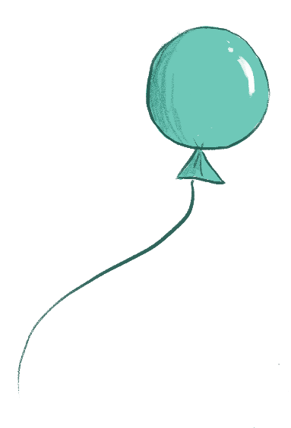
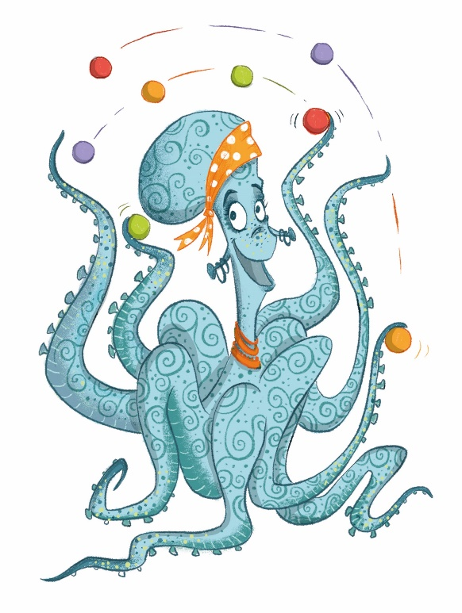
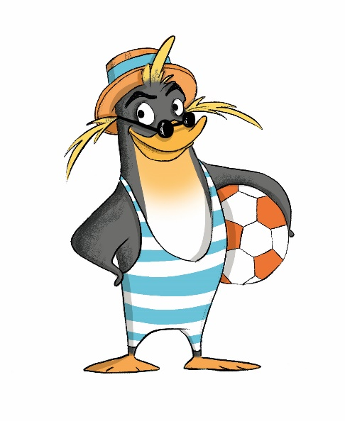
sillysquad.org.uk
Illustrations © Laura Ellen Anderson 2020 for The Reading Agency
Notes:
The Summer Reading Challenge 2020 is here! This year’s Challenge is called Silly Squad and is all about funny books, happiness and having a laugh! The Silly Squad is a team of animal friends who love to go on adventures and get stuck into all different kinds of funny books.
This year, our Challenge features extra special characters designed by the award-winning author and illustrator Laura Ellen Anderson, who you’ll know from amazing reads like Amelia Fang and Evil Emperor Penguin!
You can join the Silly Squad on a new adventure by setting your own personal reading Challenge to complete this summer. The Silly Squad website will help you keep track of your books, reviews, and the rewards you unlock along the way. How many books will you read?
If you complete your Challenge, you’ll also get a special certificate to print off and keep. The website has loads of brilliant book suggestions to get you started, and tips on how you can keep reading even while schools and libraries are closed. Did you know you can get e-books for free from your local library? You can also find heaps of super silly activities, quizzes, videos, games and more to keep you entertained at home! This year’s Challenge runs from 5 June to September, so there’s plenty of time to take part and get silly this summer.
So let’s get silly!

Slide 4
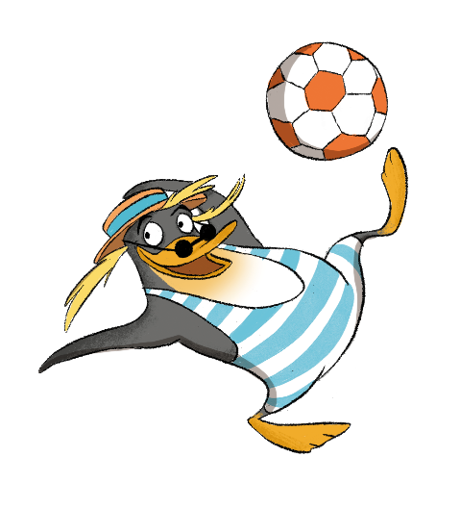
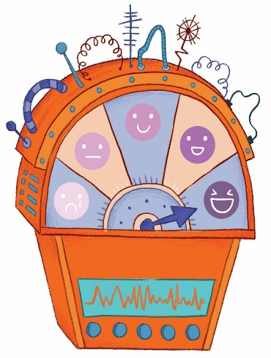
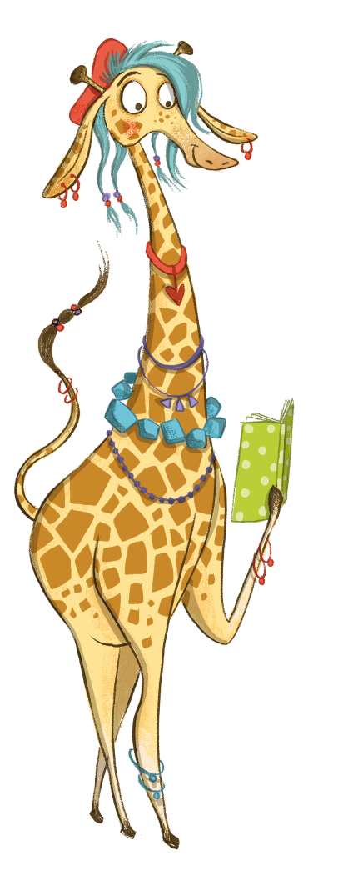
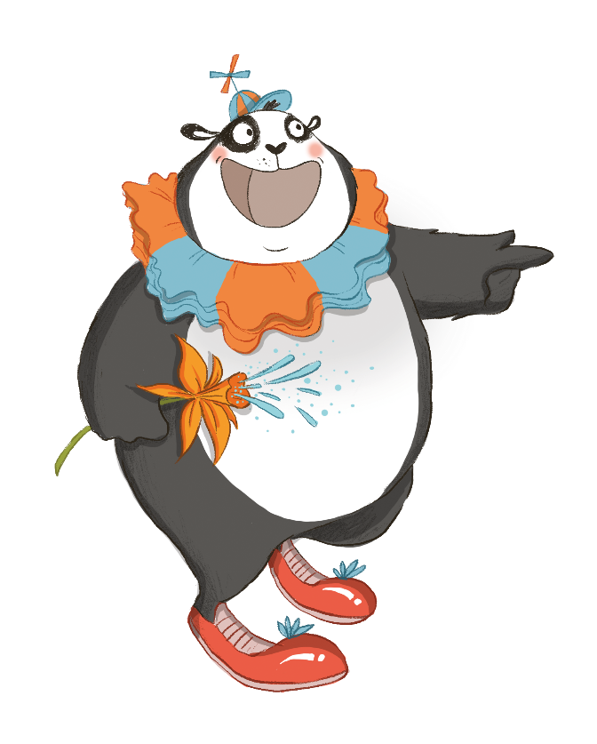
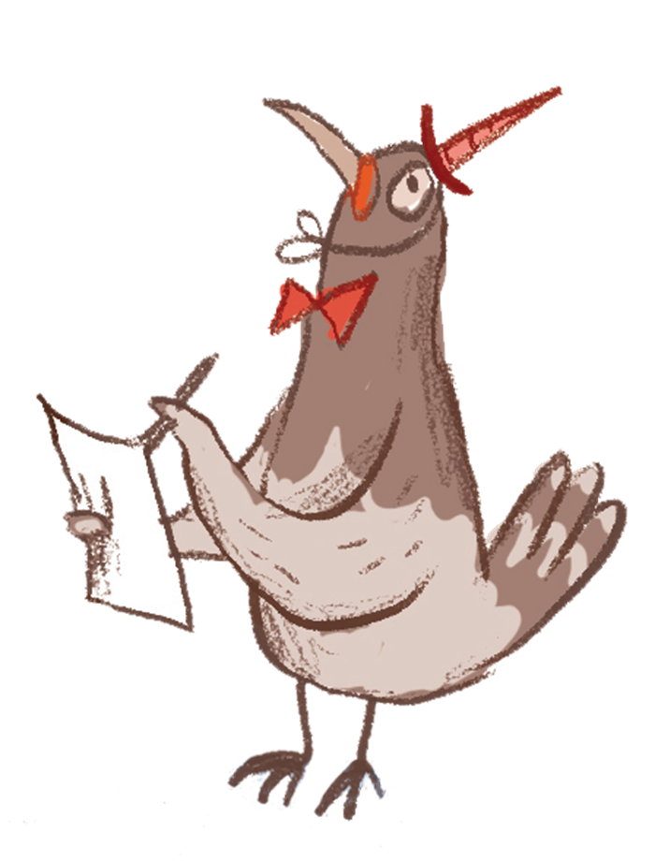
sillysquad.org.uk
Illustrations © Laura Ellen Anderson 2020 for The Reading Agency
Notes:
Which member of the Silly Squad will make the loudest noise on the laugh-o-meter? The laugh-o-meter, a clever device that lets the Silly Squad measure happiness levels and keep kids entertained. Who do you think is the funniest?
The Silly Squad
Snook the penguin ( Snŵc in Welsh)
Snook is the coolest member of the team. He’s a fish-guzzling fiend who can’t resist a funny novel!
Snook looks after the Comedy Closet and the Silly Squad’s amazing collection of fancy dress outfits, from rainbow capes and giant spotted trousers to princess dresses and carrot costumes. Any outfit can be a funny one if you’ve got the right attitude.
Izzie the octopus (Awen in Welsh)
Izzie is a wily MC! She can make up all kinds of wicked rhymes right off the top of her head (and she can juggle too!). She loves poetry.
Izzie is the boss of Slime Station, a giant room full of brightly coloured slime where fun house visitors can get active and go for a swim or jump into the tube slide.
Merry the giraffe (Sonia in Welsh)
Merry has a talent for telling tall tales and loves to relax with a spot of non-fiction.
Merry’s favourite room is the LOL Library, which is full of lots of wonderful books just waiting for readers to discover them! Merry loves to chat and is great at recommending books that the rest of the Silly Squad and their friends will enjoy.
Lily the frog (Lili in Welsh)
Lily is the stand-up comic with perfect timing, never to be seen without her trusty joke book.
In the fun house Lily is the host at the Giggle Factory, where you’ll often find her telling the most hilarious jokes! Everyone is welcome to hop on stage and share the things that make them laugh, from jokes to songs to funny stories and silly dances.
Bamboozle the panda (Bambwsl in Welsh)
Bamboozle is the clown of the bunch, and always has a trick or two up his furry sleeve! Book-wise, he’s obsessed with graphic novels and comics.
Bamboozle runs the One Stop Prop Shop, which is filled from floor to ceiling with wacky items to make you chuckle, like flowers that squirt water, giant glasses with fake noses, and spinning bow ties. Bamboozle is very creative and likes to make crafts and new props from objects he finds around the fun house.
But what is that pigeon doing?

Slide 5
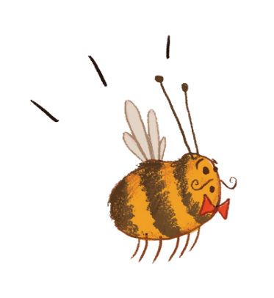
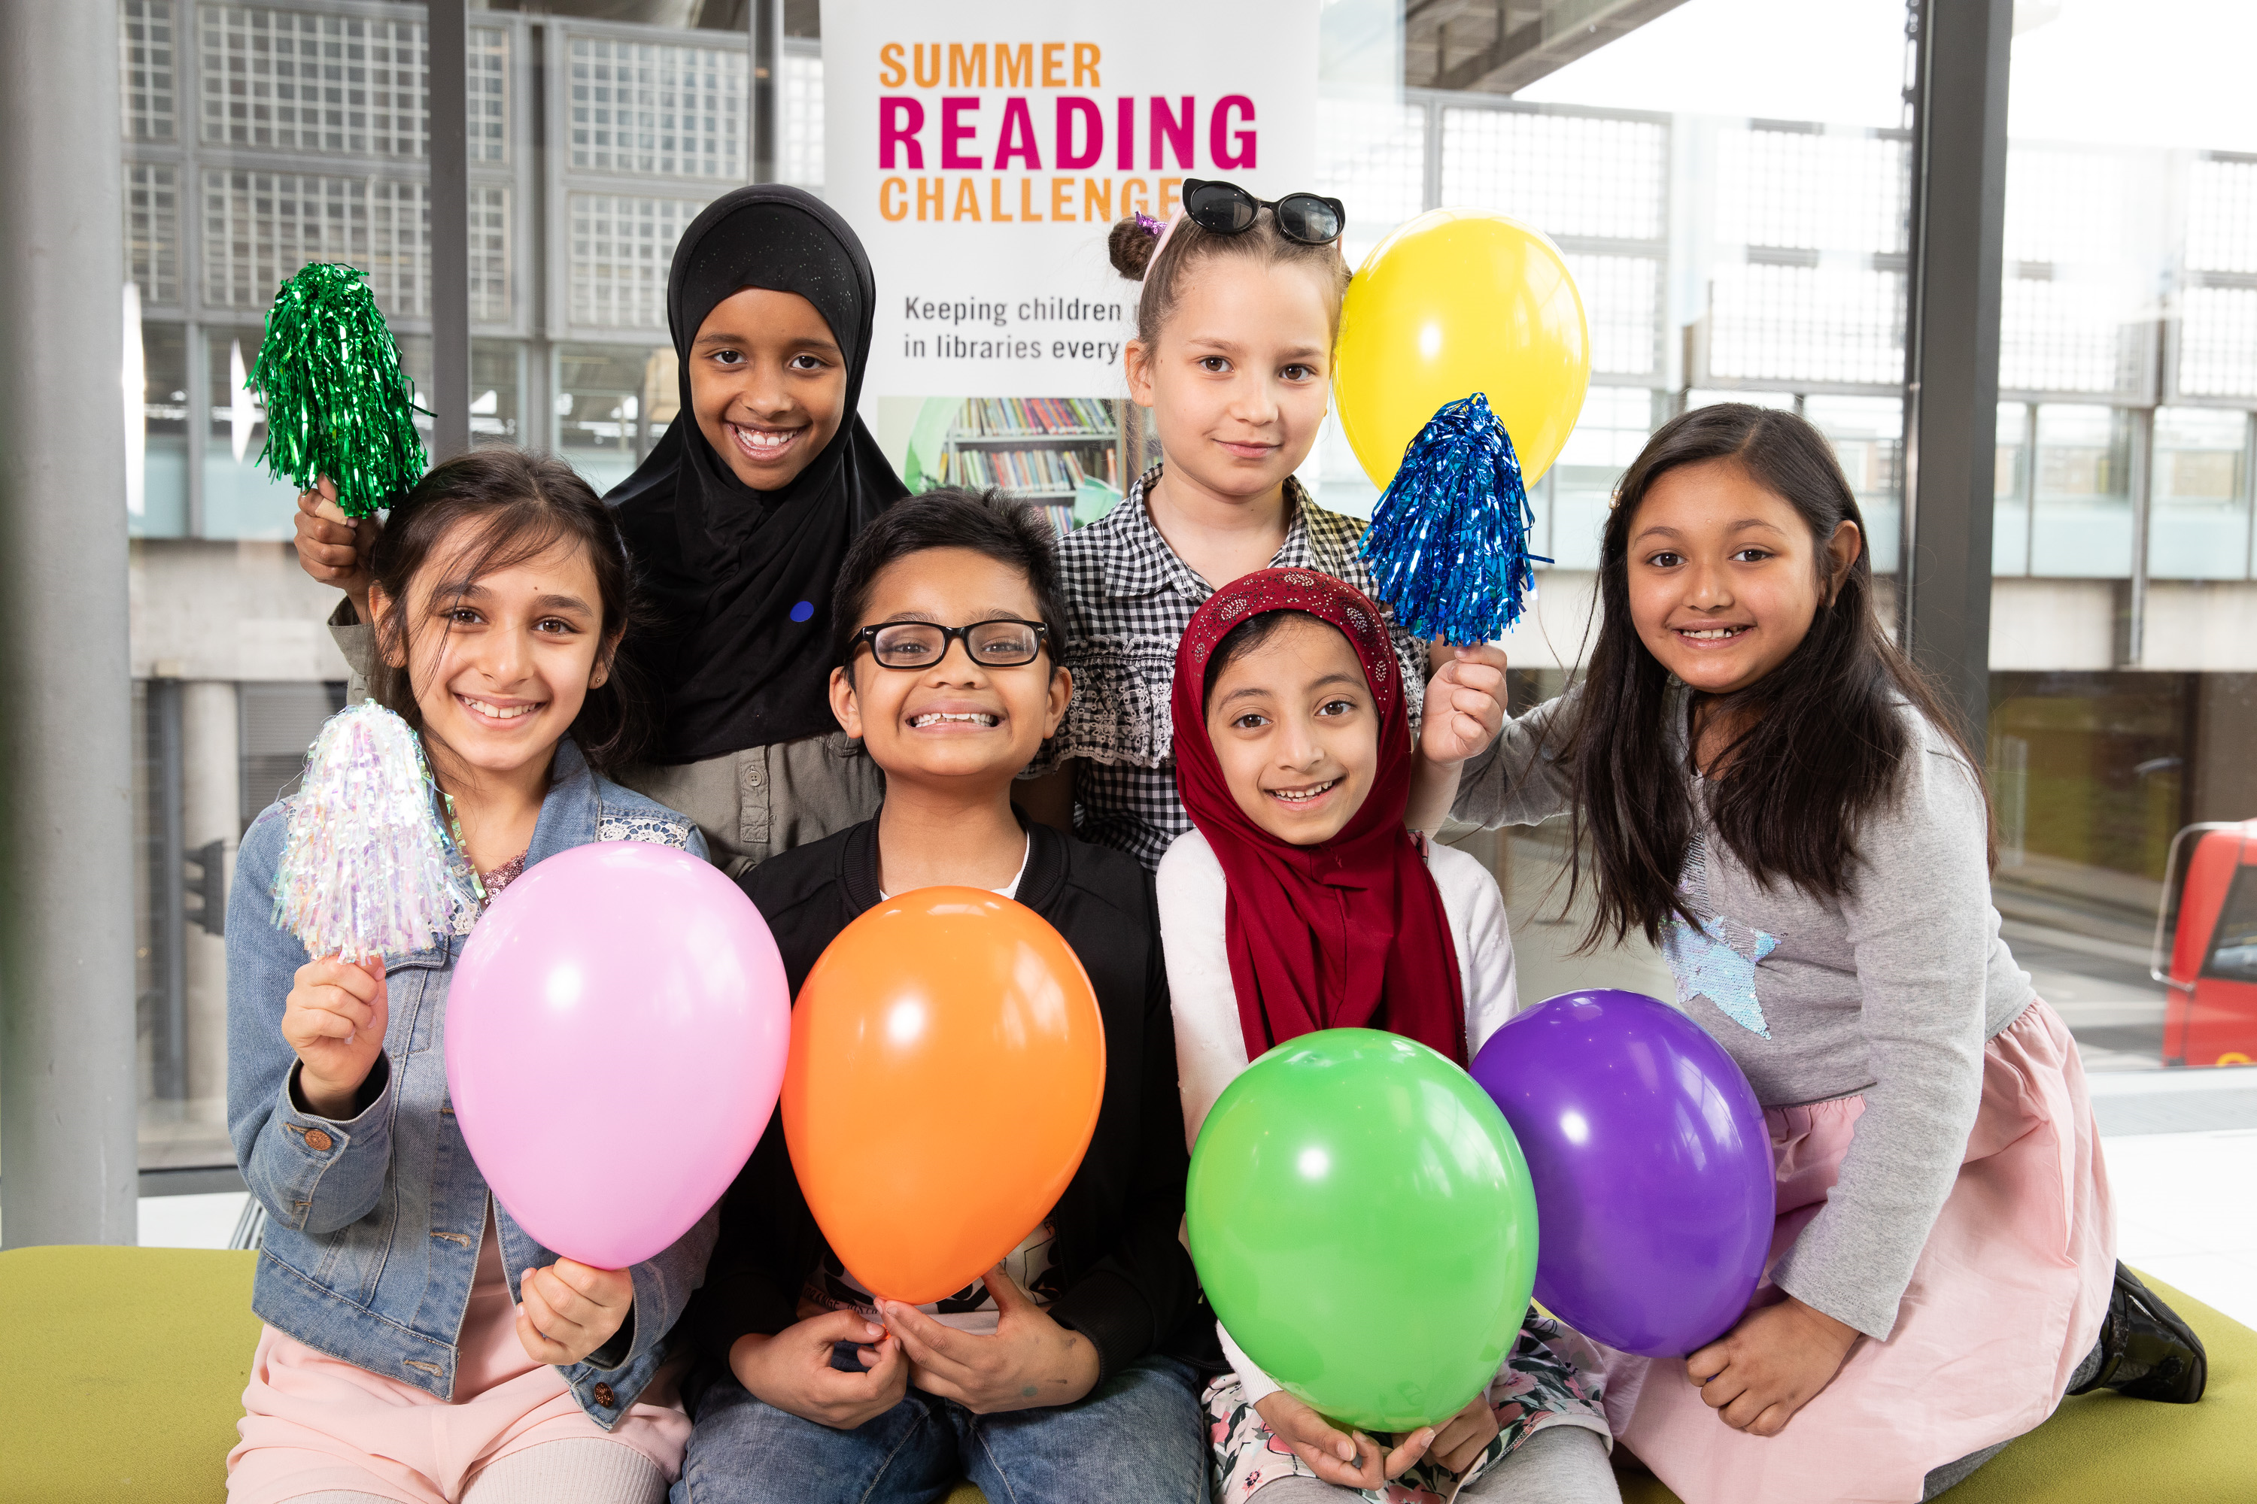
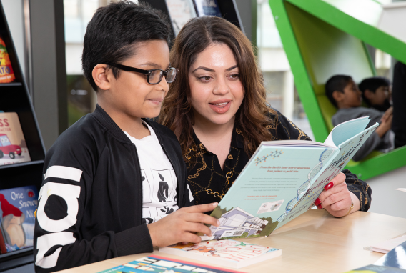
Sign up to the challenge on the Silly Squad website – IT’S FREE! You can get eBooks for free from your local library
Read at least SIX library books over the holidays
Rate and review your books to unlock badges
Play the games and download the free activities from the website
Complete the Challenge and you’ll get your own certificate
sillysquad.org.uk
Illustrations © Laura Ellen Anderson 2020 for The Reading Agency
Photographs © Dave Warren 2019 for The Reading Agency
Notes:
Think about what books make you laugh and sign up at sillysquad.org.uk.
If you already have a profile set up from previous years, you do not need to sign up again.
You can also:
Find reading recommendations from the Silly Squad and other children taking part in the Challenge
Get tips on finding books to read while the library is closed
Play games and enter competitions
Watch special videos from your favourite authors and illustrators
Take part in mini-challenges, quizzes and activities
You can also challenge yourself and read more than six! Maybe you want to try different types of books. Share your favourite books with other children taking part in the Challenge and even unlock extra rewards for your reading.

Slide 6
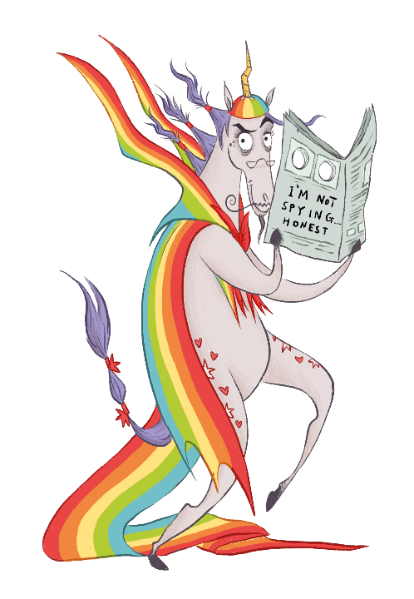
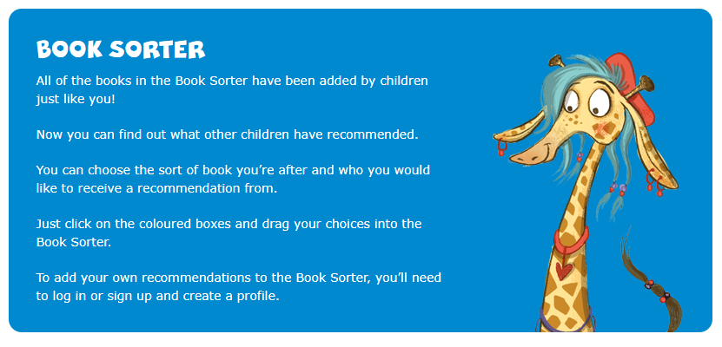
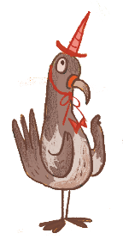
Visit our Book Sorter for book ideas!
sillysquad.org.uk
Illustrations © Laura Ellen Anderson 2020 for The Reading Agency
Notes:
There’s that pesky pigeon again! He works for Brian the pony. Brian is a total grump with no friends and no sense of humour. He’s too busy plotting against the Silly Squad to read any books and hopes his unicorn costume will throw them off the scent. No one would suspect a unicorn of getting up to mischief, would they? This naughty pony uses a flock of pigeon minions to spy on the Silly Squad and spends his days thinking up ways to spoil their fun. His chief minion and right-hand pigeon is called Norman. Brian could really do with reading a book or two and having a laugh this summer!
If you are not sure what to read during the summer like Brian then visit the Book Sorter on the Silly Squad website (sillysquad.org.uk). Nearly a million books have been added by other children on the Book Sorter so you can find out what books children have recommended and use the sorter to receive a some recommendations.

Slide 7
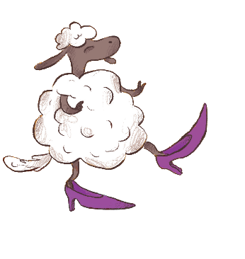
Get silly this summer and join the
sillysquad.org.uk
Illustrations © Laura Ellen Anderson 2020 for The Reading Agency
Notes:
Information for teachers
We had a whole host of virtual events with guest celebrities and authors for our launch on the Summer Reading Challenge Facebook page. The videos are still there if you would like to take a look. Follow along on our social media platforms (@readingagency on Twitter and @SummerReadingChallengeUK on Facebook) and on the sillysquad.org.uk website.
We have more information and assets for teachers in our Teachers’ Toolkit saved in the Dropbox: https://www.dropbox.com/sh/oq1lmtu50abqcb1/AABtDxQOWcIkaSZKY0oRVy8la?dl=0
Visit our School Zone for more resources which will go live on the Summer Reading Challenge website. There will also be a Home Zone for parents/carers to access to support the Challenge at home.
If you want to join in with the fun please use the hashtags #SummerReadingChallenge and #SillySquad2020
Please tag @ReadingAgency and if you’re on Facebook tag @SummerReadingChallengeUK so we can share your posts!
You may also wish to tag our illustrator, Laura Ellen Anderson. Laura is on Twitter @Lillustrator and her Instagram page is @laura_ellen_anderson

