Slide 2
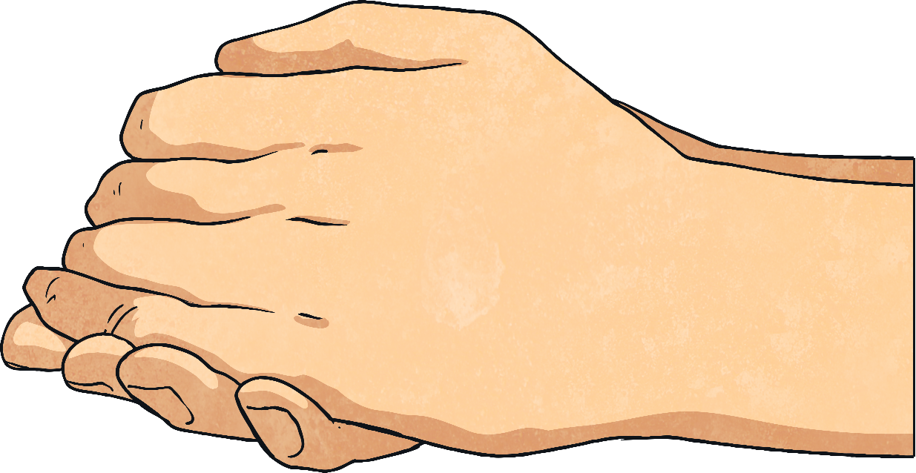
Friction
Friction occurs between two surfaces that slide against each other.
Friction is the force that acts against you when you try to move something heavy.
The rougher the surface, the stronger the friction.
Friction produces heat, like when you rub your hands together.

Slide 3
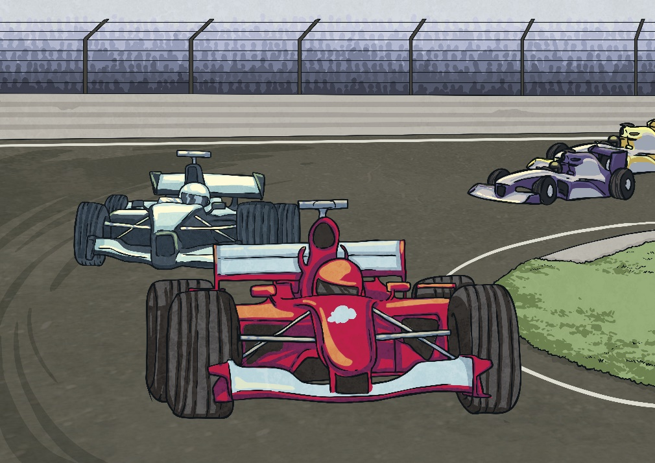
Using and Reducing Friction
Friction is useful when it helps us grip the floor with our shoes and stop car tyres skidding.
However, for people like ice skaters, it is a good thing that ice causes very little friction.
Friction can be reduced by using methods like lubrication. Your door hinges will probably be lubricated by oil to reduce the wear and tear caused by friction.

Slide 4
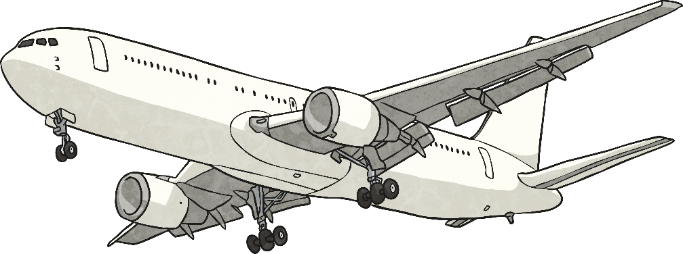
Air Resistance
Air resistance is a type of friction.
Air resistance makes it more difficult for an aeroplane to travel through the air.
The streamlined shape of an aeroplane helps to reduce air resistance.
Air resistance is also what makes parachutes work.

